Slide 1

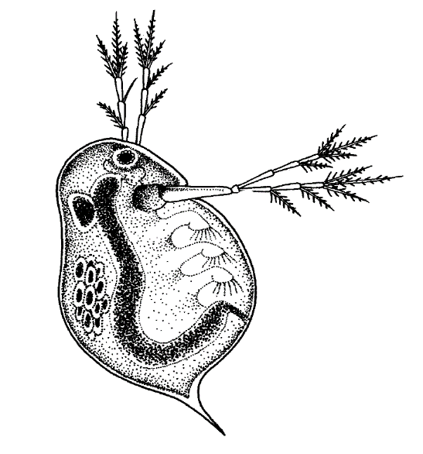
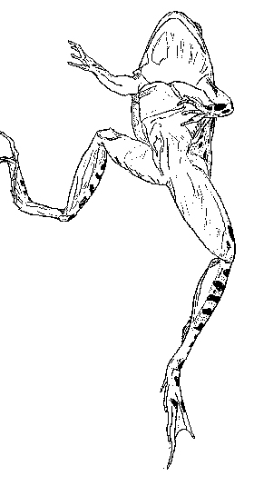
Biological Drawings
Intro to
A’ level Biology

Slide 2
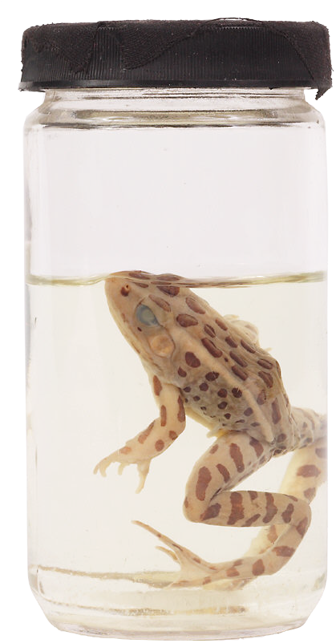

Why Are Drawings Important? (1)
Biology is a science and as such requires accurate observations of both living and preserved specimens.
Drawings can present massive amounts of information that are very difficult to express in words, i.e. relative proportions, numbers and locations of structures.

Slide 3
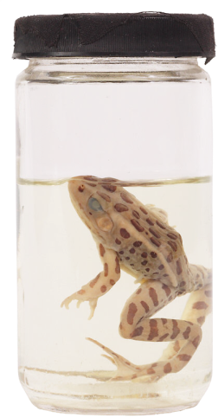
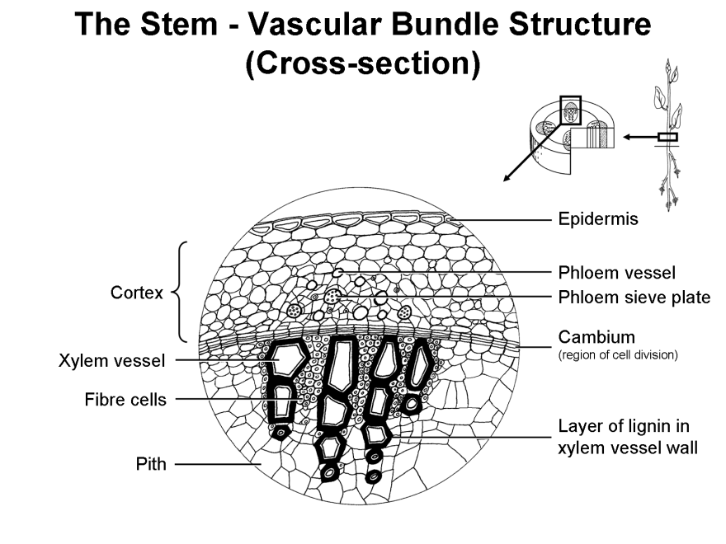
Why Are Drawings Important? (2)
Drawings should therefore be a viewed as a very efficient means of summarising and displaying academic biological information in an
accessible and personal way.
Drawings should also provide a very useful aid to exam revision - actually studying and drawing a specimen will help you understand its structure and function and you will benefit when examination questions are based on a drawing or diagram.

Slide 4
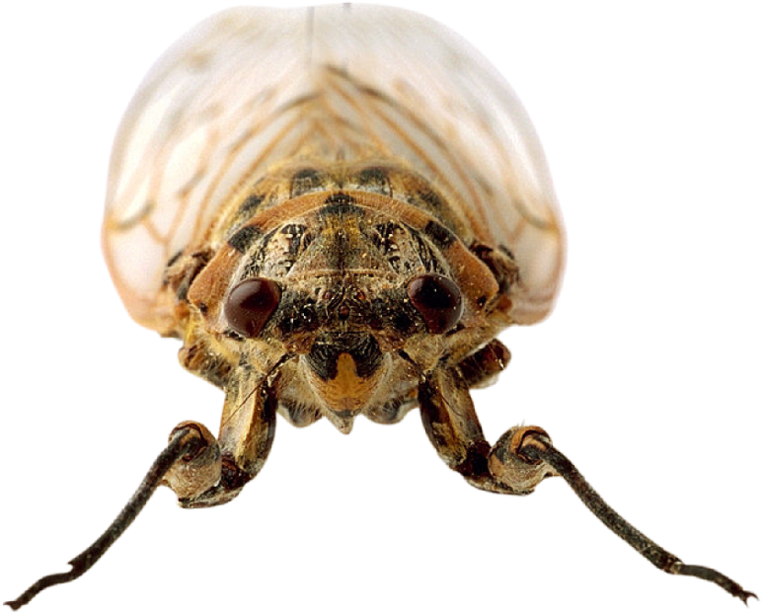
Biological Drawings
Why not just label photographs?
Photographs and photomicrographs contain massive amounts of information about a specimen - you often ‘cannot see the wood for the trees’. A drawing should highlight the key structures in a specimen and can be a composite of different aspects, different focal depths and extended observation.
This photograph of a cicada has a shallow depth of focus - the thorax and abdomen are both out of focus.

Slide 5
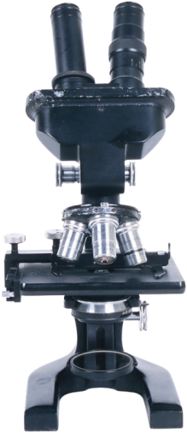
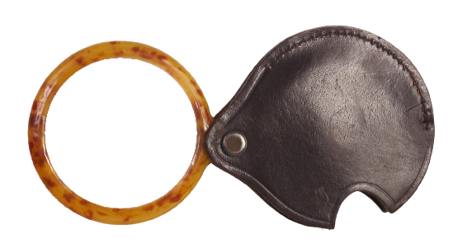
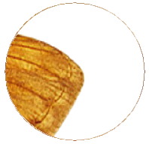
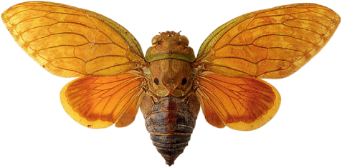



Magnification (1)
Magnification is the term that describes the apparent enlargement
of an object by a lens or microscope.
Original
object x1
Magnification
x2

Slide 6

Magnification (2)
Magnification does not have a unit but the value is prefixed by an ‘x’ which denotes ‘times’.
Original
object x1
Magnification
x2

Slide 7
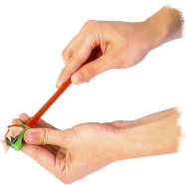

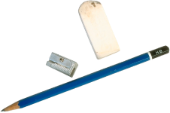

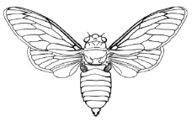

The Protocol For Biological Drawings (1)
1. The drawing should be done on plain white paper with a sharp HB pencil. Use a soft eraser to alter or correct.
2. Decide on landscape or portrait mode so as to allow sufficient space for labels.
or
Landscape
3. Make your drawing a good size as larger drawings are clearer to understand and label.
Portrait
or
4. Place your drawing in the centre of the page and leave enough room either side for your labels and annotation.
or

Slide 8
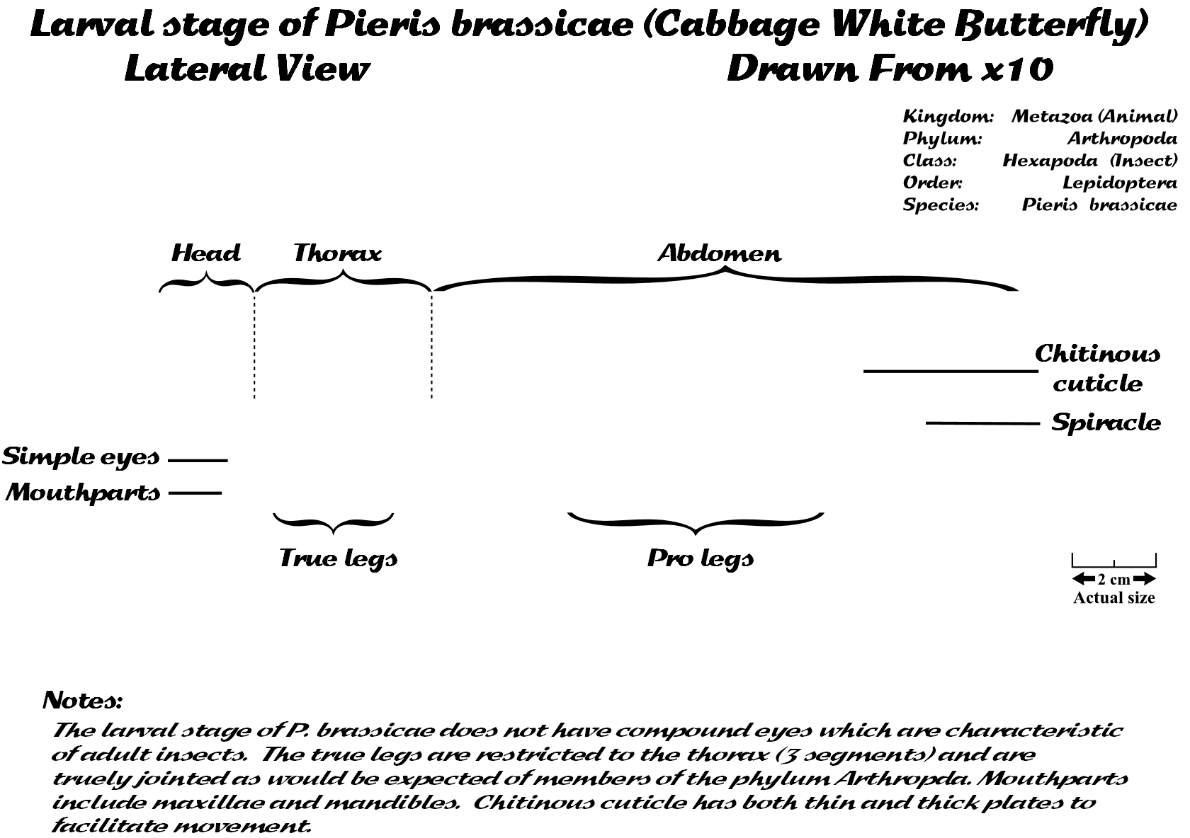
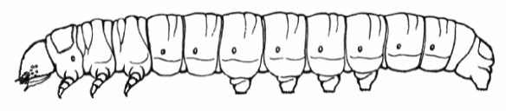
The Protocol For Biological Drawings (2)
5. Do not colour, shade or cross-hatch on your drawing. Normally this is only acceptable to distinguish tissues as in plan views and embryology.
6. Label lines should not have arrow heads as these can obscure structures. Label lines, labels and annotations should all be done in pencil. Ink can be used for titles and notes.
7. Annotate your drawing with comments that are worthy of note and that will help you revise and prepare for exams. Place short comments (annotation) next to relevant labels to link structure and function.
8. Always include a title that accurately describes your drawing. The title should identify the specimen, the section or view drawn and the relative scale or magnifications used. Classify the specimen using your knowledge of taxonomy.

Slide 9

Before You Start Drawing
1. Generally observe and investigate the whole specimen from different views and or magnifications - even if you are only going to draw a small section or a particular system. You should be able to understand how your selection relates to the whole organism.
2. Now use some form of magnification to facilitate your study of the views or features that will enable you to produce the required drawing.
3. Remember your aim is that the drawing should
accurately represent the specimen. You do not have to be a good artist to do this well!
5. Now draw the specimen, making sure that you keep to the protocol for biological drawings.

Slide 10
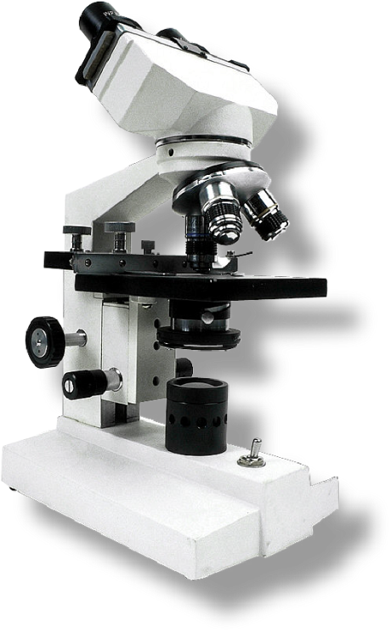
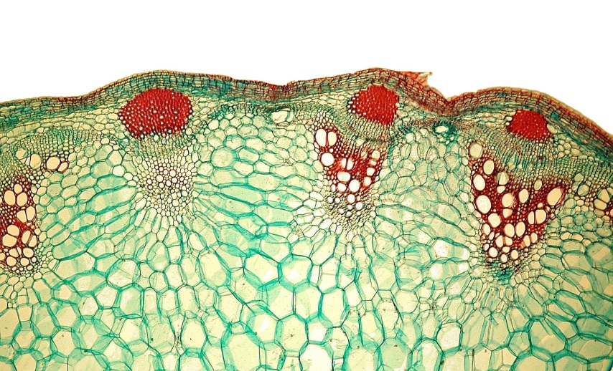
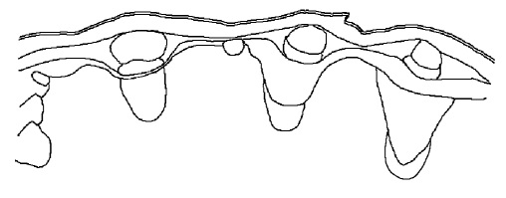
Drawings Made From Microscopic Examination (2)
Plan View
(Low Power Magnification)
Helianthus - TS of Stem to show vascular bundles - drawn from x40
N.B. Individual cells are not shown on a plan view and the drawing attempts to show tissue arrangements.

Slide 11
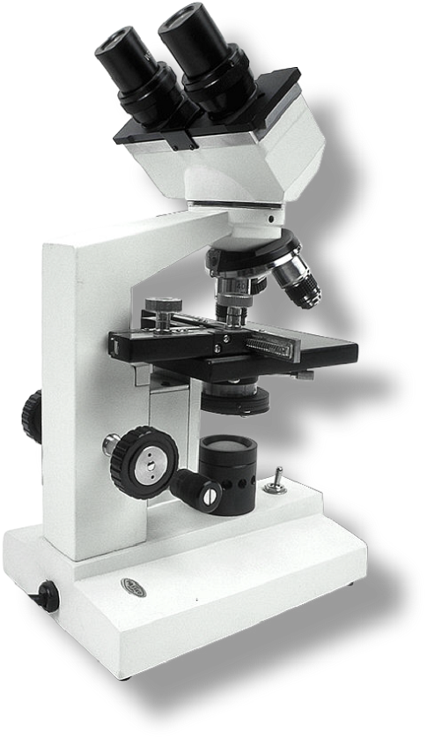
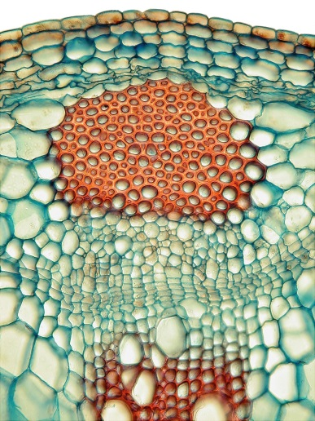
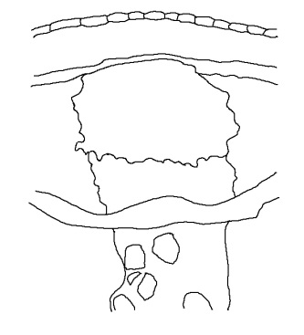
Drawings Made From Microscopic Examination (3)
Plan View
(Medium Power Magnification)
Helianthus - TS of Stem to show vascular bundle - drawn from x200
N.B. In this case individual cells are shown only for the epidermis as this will indicate that it is only one cell thick.
Otherwise tissue arrangements are shown.

Slide 12
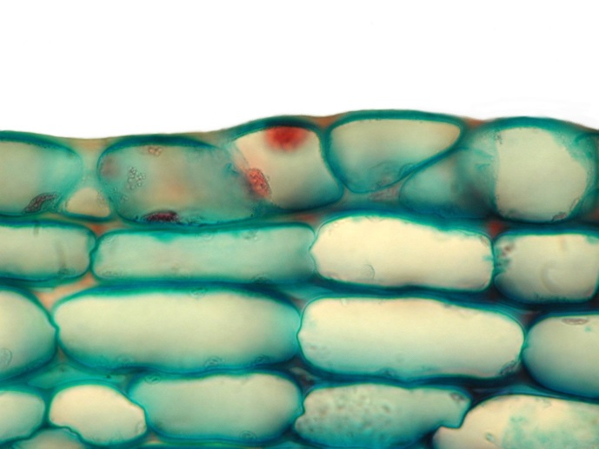
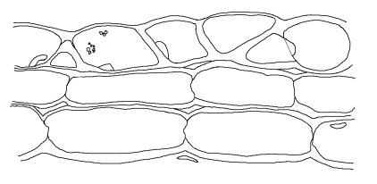
Drawings Made From Microscopic Examination (4)
Fine View
(High Power Magnification)
Helianthus - TS of Stem to show epidermis and collenchyma - drawn from x1000
N.B. Only a small number (group) of individual cells are shown. The cells that are drawn should be selected to be representative of the relevant tissues.

Slide 13
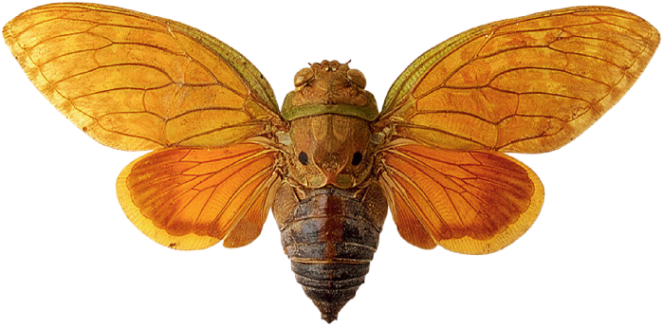

Drawings Made From Entire Specimens
The preserved cicada specimen is to be drawn to show the characteristic features of the Class Hexapoda (Insect) and Order Homoptera.
Notice how the detail shown in the drawing is reduced to the outlines of the structures. The colours of the preserved specimen are different from those of a live specimen and so are not reliable or worth recording.
Labels and annotation should refer to characteristic features.
Members of the Order Homoptera are distinguished by piercing and sucking mouthparts arising from the lower back margin (rather than the front) of their heads. Their front wings are thickened and of a uniform texture for their entire length. Antennae slender and short (bristlelike).
The Homoptera are among the most abundant herbivores found in terrestrial habitats and many species are crop pests. Aphids and leafhoppers also carry many serious plant diseases. Homopteran cicadas are among the loudest animals in the world.

Slide 14
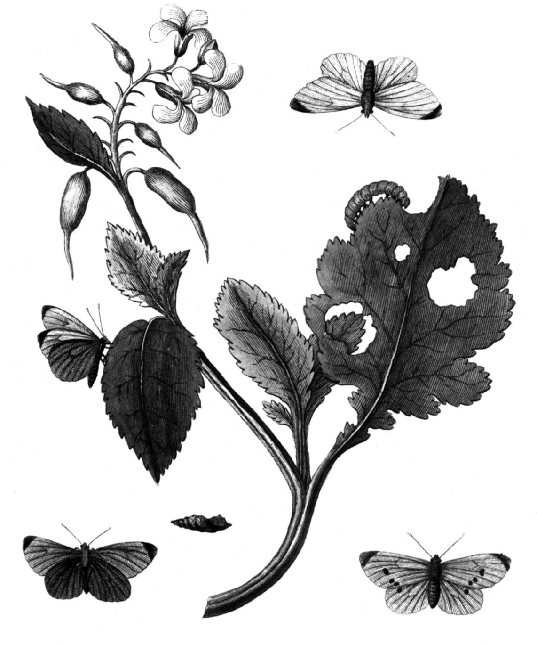
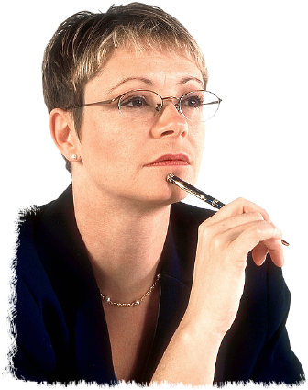
Example
Task:
Students were asked to draw, label and annotate a specimen of the larval stage of the Cabbage white butterfly to illustrate its important taxonomic and anatomical details (external). The actual drawings will be commented on as it is the drawing and not the labels, etc. that are assessed.

Slide 15
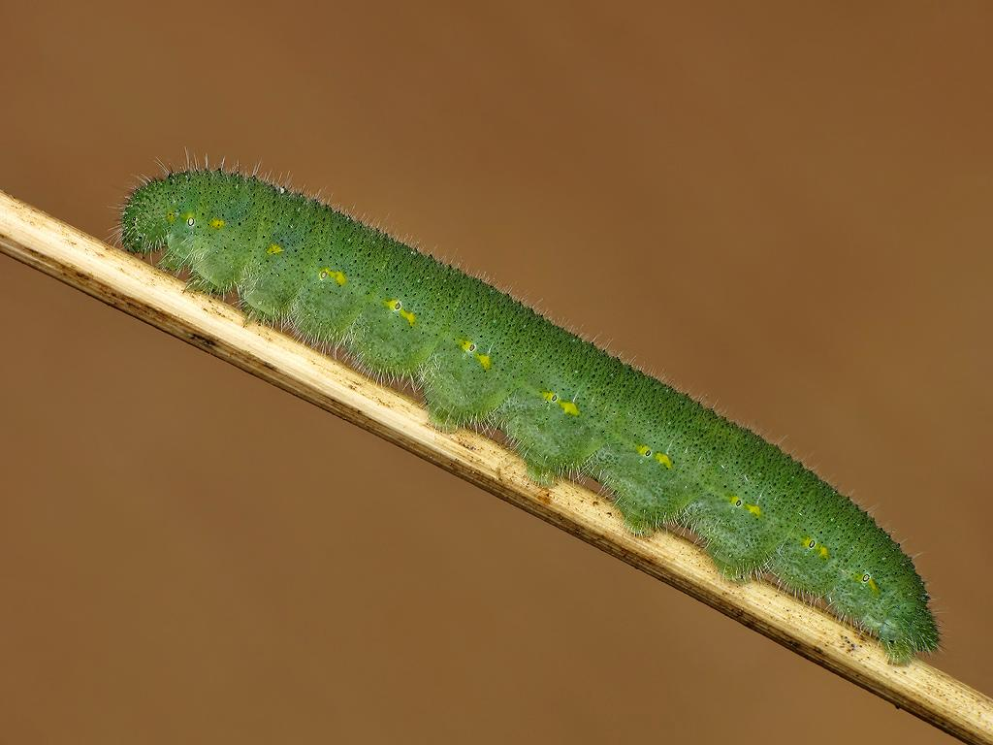
Cabbage white larvae

Slide 16
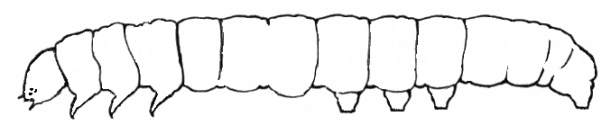
Examiner’s Comments (1)
This drawing shows many minor and major inaccuracies, e.g.
1. spiracles have not been shown on the drawing (major).
2. the first pair of prolegs has been omitted (major).
3. the true legs are not shown as articulated (major).
4. the segmentation of the first three abdominal segments is not clearly defined (minor).
As more than one major inaccuracy is present this drawing would receive a performance level of 0 for the drawing skill.

Slide 17
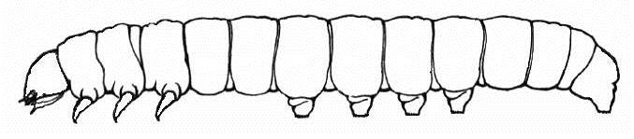
Examiner’s Comments (2)
Although this drawing contains more detail than the previous example it still possesses several inaccuracies, e.g.
1. spiracles have not been shown on the drawing (major).
2. the first pair of prolegs has been omitted (major).
3. the true legs are not shown as articulated (major).
As more than one major inaccuracy is present this drawing would receive a performance level of 0 for the drawing skill.

Slide 18
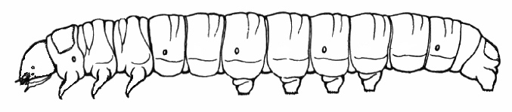
Examiner’s Comments (3)
This drawing shows several inaccuracies, e.g.
1. some spiracles have not been shown on the drawing.
2. there are two few simple eyes present in the drawing
3. the true legs are not shown as articulated (major inaccuracy).
Many aspects of this drawing are good. However, as there are several inaccuracies present this drawing would receive a performance level of 1 for the drawing skill.

Slide 19
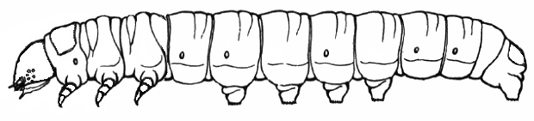
Examiner’s Comments (4)
Although this drawing is a very good representation of the specimen it shows more than one minor inaccuracy, e.g.
1. one of the most anterior abdominal segments has been omitted from the drawing.
2. some spiracles have not been shown on the drawing.
These errors in translating observation into a drawing reduce the overall reliability of the ‘accuracy of the drawing’ and therefore this would receive a performance level of 2 for the drawing skill.

Slide 20

Examiner’s Comments (5)
This drawing shows all of the necessary anatomical features which accurately represent the actual specimen, e.g.
1. spiracles are accurately shown.
2. the four pairs of prolegs have been drawn.
3. the true legs are shown as articulated.
4. the segmentation of the body is clearly defined.
5. simple eyes are accurately drawn with respect to size, number and position.
This drawing would receive a performance level of 3 (the highest) for the drawing skill.

Slide 21
The Student’s Notes (6)
The final part of the drawing is to label, annotate and add a title and scale. If such a drawing appeared in a student’s file they would find it very useful for revision purposes.

Slide 22
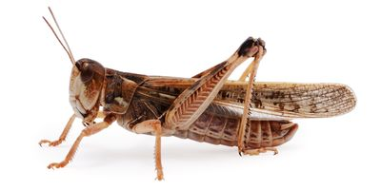
Task
Draw a biological diagram of the locust. Use the next slide to help you label it.

Slide 23
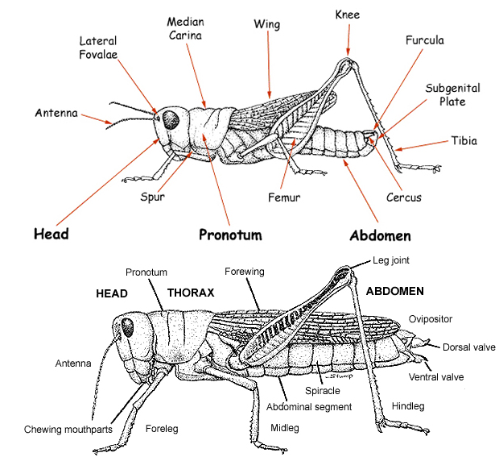

Slide 24
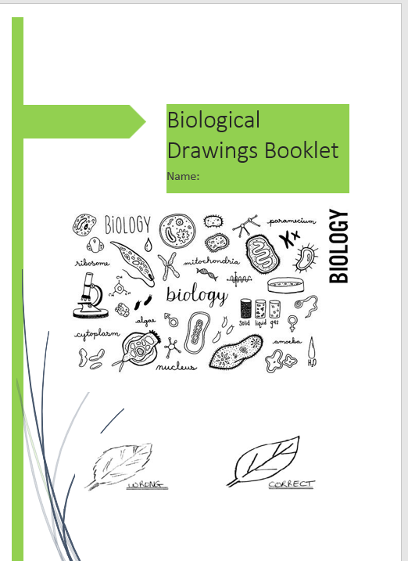
Independent work

Slide 25

End Show
Look forward to seeing you in September

