Slide 1
Alevel Chemistry
Introduction Lesson
Mr Emerson CDS

Slide 2
Introduction to Alevel Practical Chemistry
Safety is everything! You will be using some of the most dangerous chemicals available, with regular frequency. You will need to learn how to risk-assess and know how to safely handle any chemical you are about to use. Remind yourselves about the different hazards

Slide 3

Hazard Symbols
How many of these could you name right now?

Slide 4

PPE
Provided with
Optional
School goggles
Labcoat
Lab book (experiments only)
Access to fume cupboard
Different types of gloves
Your personal goggles

Slide 5
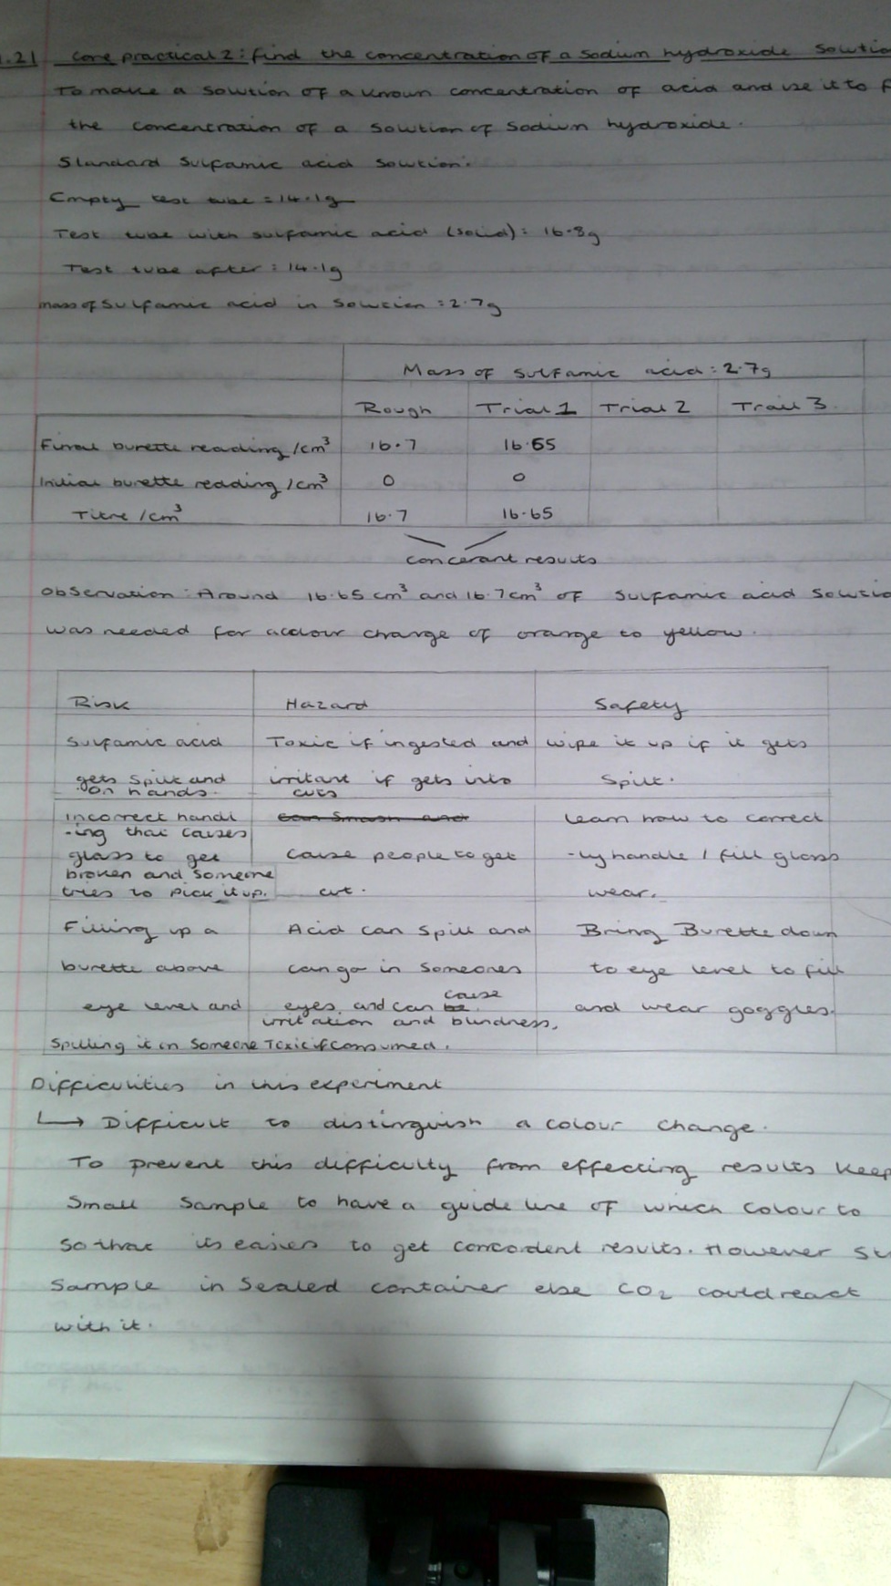
Lab books
This is where you write your risk assessments, record all your results, write conclusions and answer questions
Risk assessment

Slide 6
How to write a risk assessment:
Stage 1: Risk column
Write how using something could become dangerous; eg:Getting concentrated sulphuric acid on your hand, NOT just writing concertated acid
Stage 2: Hazard Column: What harm will come to you if the risk in stage 1 were to happen
Stage 3: Safety Column – How can we prevent step 1 from happening? – e.g..wear heavy latex gloves.

Slide 7
Task!
Research how to make the drug aspirin.
What equipment will you need?
What chemicals will you need?
Attempt to write a risk assessment for the 5 most hazardous parts of doing this experiment.

Slide 8
Thank you
Mr Emerson
aemerson@coombedean.co.uk

