Slide 1

Welcome to A Level Computer Science
Mr Gorvin

Slide 2
OCR A level course structure
 | Component 1: Computer systems | Component 2: Computational thinking, algorithms and programming | Practical programming experience
How is it assessed | Written exam 2 hour 30 minutes | Written exam 2 hour 30 minutes | Marked by your teacher and moderated by examboard.
How much is it worth | 140 marks Worth 40% | 140 marks Worth 40% | 70 marks Worth 20%
Other information | A series of short-answer and extended-answer questions. | A series of short-answer and extended-answer questions. | Assesses student's ability to use the knowledge and skills gained through the course to solve or investigate a practical problem.

Slide 3
Key Information:
Unit 1: Computer systems
Students are introduced to the internal workings of the (CPU), data exchange, software development, data types and legal and ethical issues. The resulting knowledge and understanding will underpin their work in the NEA programming project.
It covers:
Characteristics of processors, input, output and storage devices
Software development
Networking and the Internet
Programming techniques
Cyber security
Effect of digital technology on society
Unit 2: Algorithms and programming
This builds on component 01 to include computational thinking and problem-solving.
It covers:
What is meant by computational thinking (thinking abstractly, thinking ahead, thinking procedurally etc.)
Problem solving and programming – how computers and programs can be used to solve problems
Algorithms and how they can be used to describe and solve problems.
Programming Project
Students are expected to apply the principles of computational thinking to a practical coding programming project. They will analyse, design, develop, test, evaluate and document a program written in a suitable programming language.

Slide 4
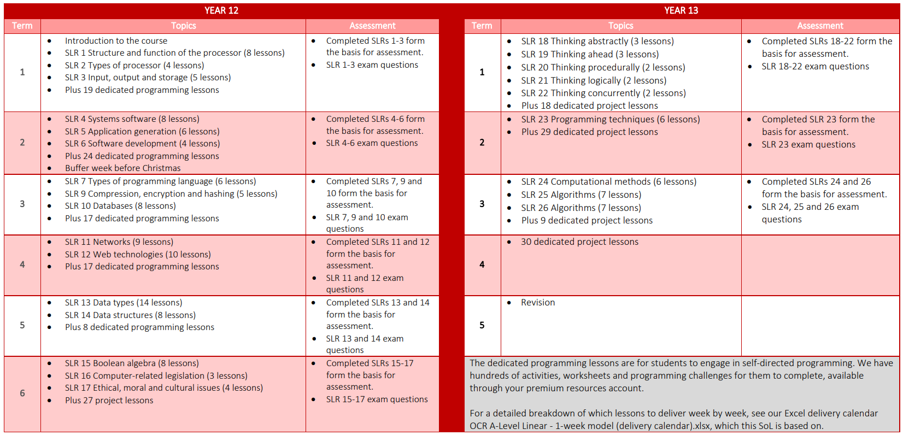

Slide 5
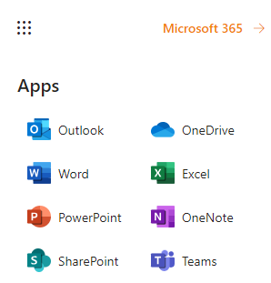
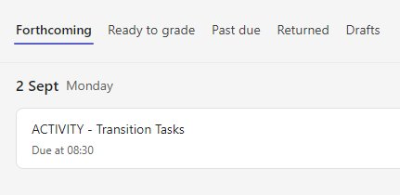
Go to: www.outlook.com
Sign in with your school email/password
Click ‘Microsoft Teams’ icon
(found by clicking the square icon in top corner)
Select Team ‘Y12 – A Level Computer Science’
Go to ‘Assignments’

Slide 6
What is a typical (theory) lesson like?
Starter
Interleaving questions (Past, Previous, Present)
Independent Learning check (Notebooks)
Introduction
Teaching / Discussion of topic covered in Independent Learning
Answering any questions
Activity
Task based on topic being covered e.g. Word doc
Plenary
Smart Revise (Quiz mode)
Independent Learning set (Due next lesson)

Slide 7
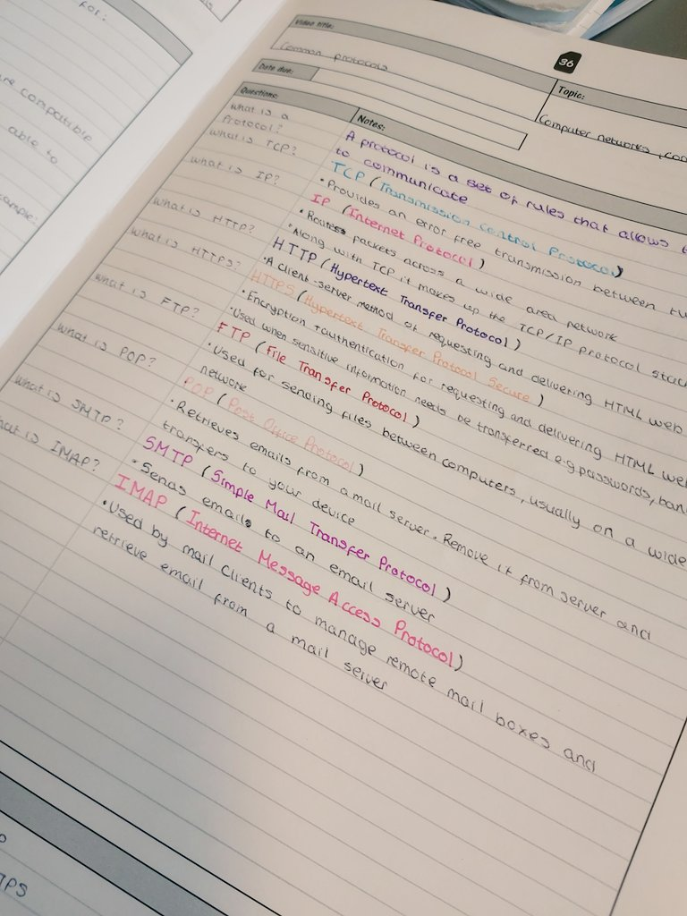
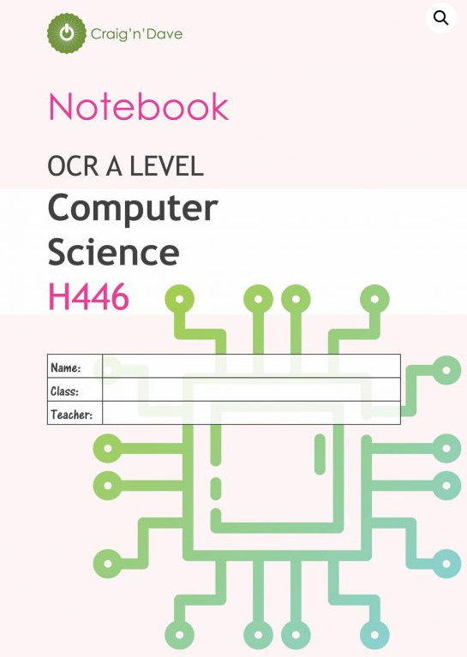
Introducing your new cornell notes book
A simple clear way of organising your notes for the topics we learn about (the main points you need to learn and remember)
Each topic section has a page to record the key points from Video watched
Based on a system called ‘Cornell Notes’ (created by Cornell University, USA)
Will make it MUCH easier to present your knowledge, revise, and to check/mark your learning

Slide 8
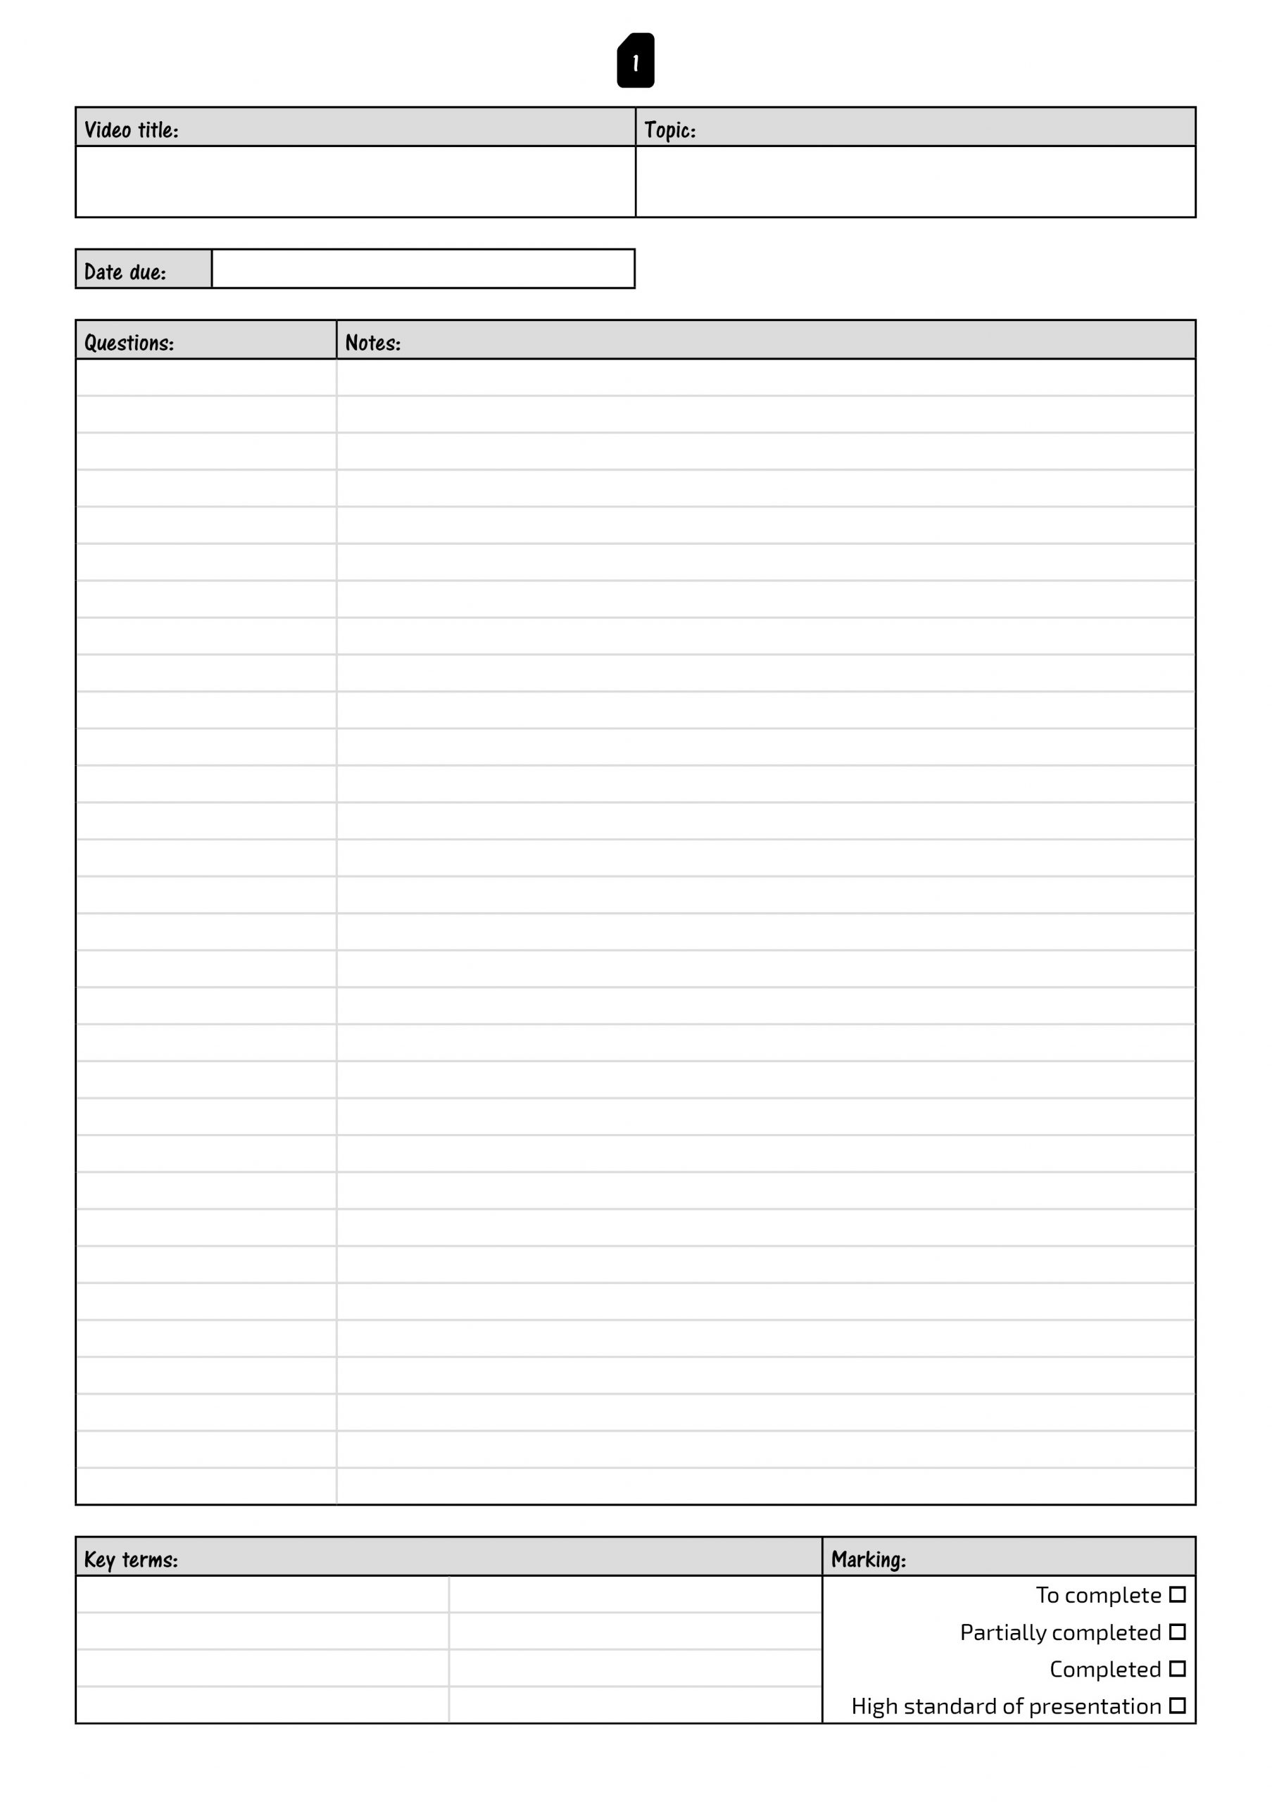
How does it work?
Every page has this basic simple layout
Title of video goes here
e.g. 1.1.1a – ALU, CU, Registers and Buses
Title of topic unit goes here e.g. SLR1 – Structure and function of the processor
Date due goes here e.g. Monday 10th January 2022
Your notes on the topic go here.
These are the ‘Key Points’ (not an essay). This could include…
Keywords & ideas
Important words / dates / people / places
Ideas/brainstorms
Diagrams & Pictures
Formulas
Key Questions will go here
e.g. What is a protocol?
What is TCP/IP?
Key terms that we have covered to remember go here e.g. Protocol, TCP/IP, Packet Switching

Slide 9
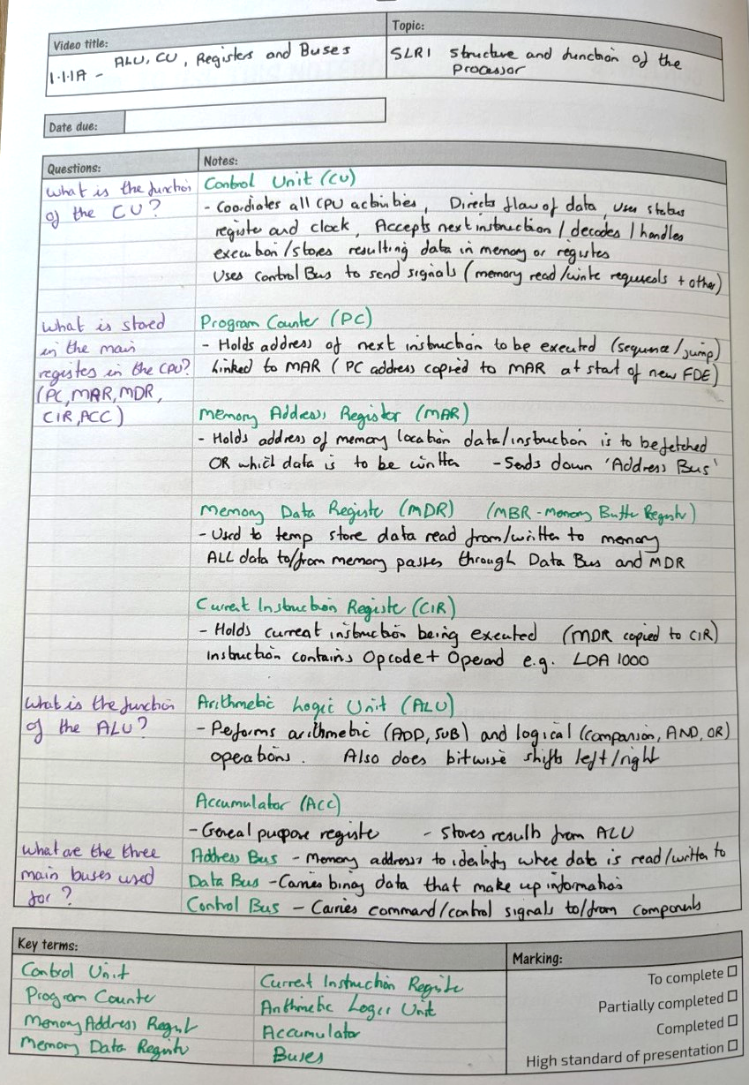
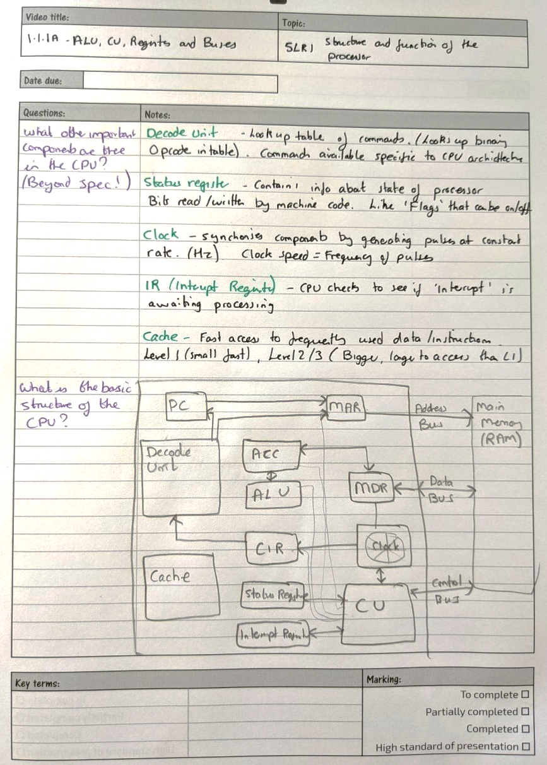
Example…
1.1.1a – ALU, CU, Registers and Buses
SLR1 – Structure and function of the processor
Presentation is VERY important.
They are your NOTES so they need to be clear and concise (easy to read back and understand)
You can use different techniques to present…
Coloured pens
Highlighters
Underline
Bullet points
Diagrams
I will be checking these books regularly and looking for the BEST presentation (regular rewards for best/most improved)
TAKE PRIDE IN YOUR NOTES, THEY ARE YOURS, TAKE OWNERSHIP
What is a protocol?
A set of rules for how devices communicate and how data is transmitted across a network
What is TCP/IP?
TCP (Transmission Control Protocol)
–In charge of how devices connect to network.
Splits data up into packets, reassembles packets into correct order, checks data sent and delivered correctly
IP (Internet Protocol)
– Responsible for directing the packets using Packet Switching

Slide 10
Craig’n’Dave Videos (DEMO & DISCUSS)
https://student.craigndave.org/a-level-videos
student.craigndave.org

Slide 11
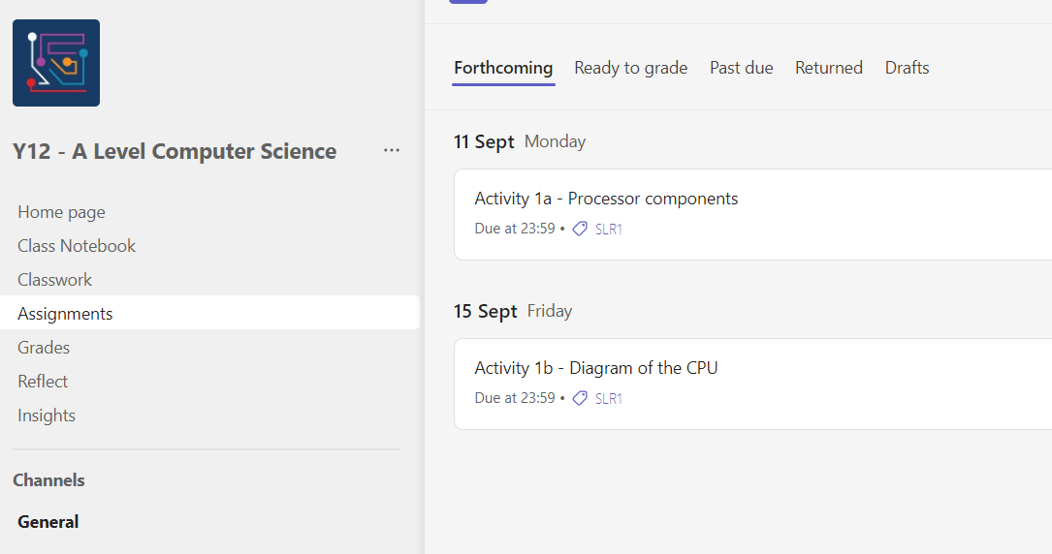
Explaining the Activities

Slide 12
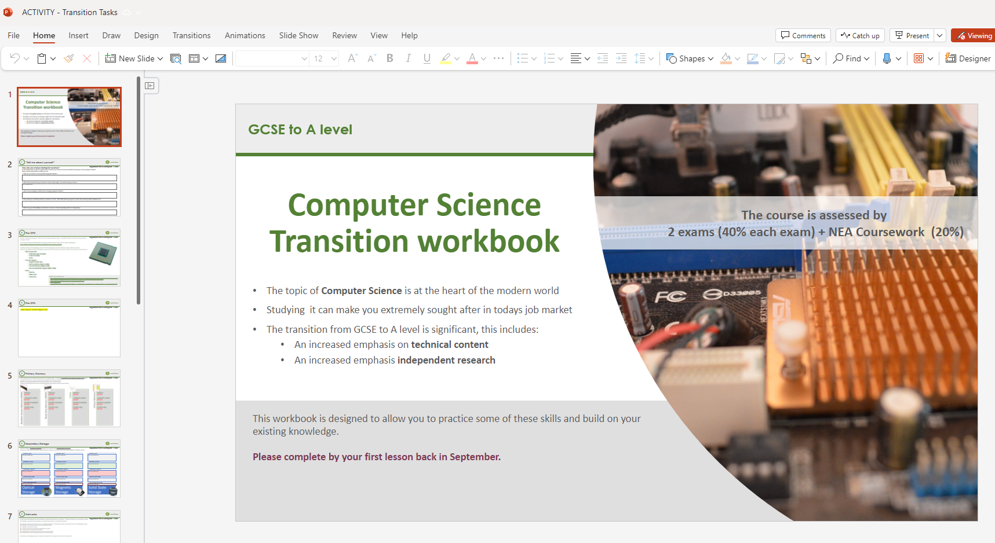
Transition Tasks

Slide 13
TASTER LESSON
- Run Length Encoding
(Lossless Compression for Images)

Slide 14
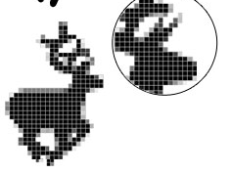

Quick Recap…
Bitmap images - Saving as ‘Binary’
How does computer save ‘Bitmap’ image as binary?
Image divided up into pixels
A pixel can only be one colour at a time
The colour of each pixel stored in binary
The more bits used to store each pixel, the more colours!
Example!
8px X 8px (64 pixels total)
Only black and white used
Single bit used to store each pixel
1=black 0=white
Image can be stored with 64 bits
(or 8 bytes!)
8px
8px

Slide 15
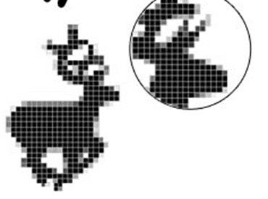


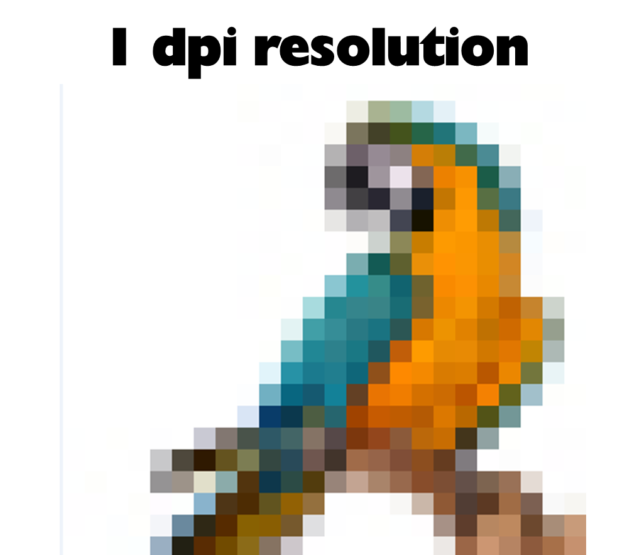
Quick Recap…
Bitmap images - Things you need to know…
Remember, we have now looked at:
Pixel = Short for ‘Picture Element’. A single block
of colour in an image. Pixel stored as binary code.
Colour depth = Number of bits per pixel in an image (more bits = more colours can be used)
Dimensions = Height x Width in pixels
(e.g. 800px x 500px image = 400,000 pixels)
Can be used to work out total number of pixels!!!
Resolution = Concentration of pixels per area
(e.g. pixels per inch or cm)

Slide 16

The size of files are very important when saving them. To help with this, we use ‘Compression’.
QUESTION – What is compression?
Data compression is when we make file sizes smaller, while trying to make the compressed file as close to the original as possible.
QUESTION – What are the benefits of using compression?
Smaller files take up less storage space on devices
Streaming/Downloading from Internet is quicker (less bandwidth used)
Much easier to send content via email (often have restrictions on file sizes!)

Slide 17
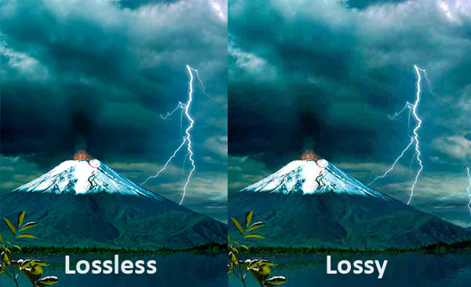
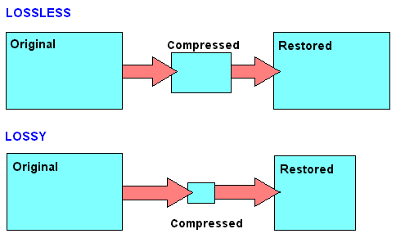
There are Two Types of compression…
Lossy and Lossless
Lossy Compression –
Works by permanently
removing data from the file
(file size is reduced because
less bits saved)
Lossless –
Makes file size smaller by temporarily removing data to store the file, and restores it to its original state when opened

Slide 18
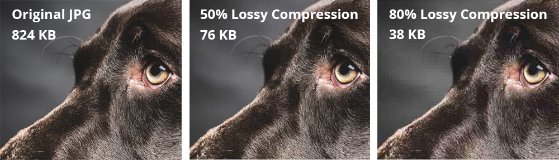
Lossy Compression –
Works by permanently removing
data from the file (file size is
reduced because less bits saved)
Pros
Greatly reduced file size!
Less bandwidth for download & streaming
Very common – can be read by lots of software
Cons
Loses data (cannot be returned to original!)
Can’t be used for text or software files (these types need to keep all original information)
Worse quality than original
Examples of file types…
MP3 (audio)
AAC (audio)
JPEG (image)

Slide 19
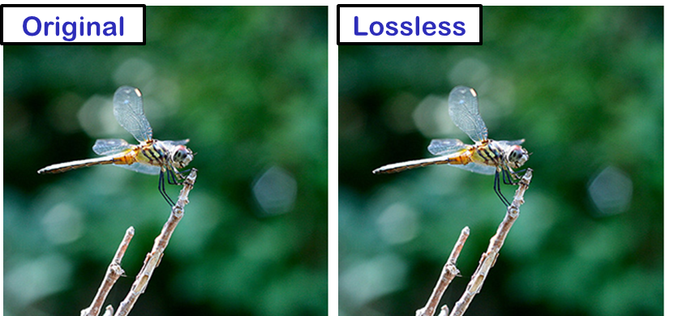
Lossless Compression –
Makes file size smaller by temporarily removing data to
store the file, and restores it
to its original state when opened
Pros
Data only temporarily removed, no reduction in quality!
Files can be decompressed and turned back to original
Can be used on text and software files too
Cons
Only slight reduction in file size (still takes up quite a bit of space on your device)
Examples of file types…
FLAC (audio)
TIFF (image)
PNG (image)

Slide 20
Lossless Compression –
Makes file size smaller by temporarily removing data to
store the file, and restores it
to its original state when opened
There are two types of Lossless Compression you need to learn about at A Level
RLE (Run Length Encoding)
Dictionary Encoding
QUESTION – What is RLE (Run Length Encoding)?
2 minutes – Search and Find out!
https://www.youtube.com/watch?v=3gHmQW9rgoI

Slide 22
Consider this icon of a space ship that could be used in a typical computer game to represent a player life.
A white pixel is represented with a 1. A black pixel is represented with a 0. The data is stored as a stream of 0’s and 1’s in a file.
1 | 1 | 1 | 1 | 1 | 1 | 1 | 1 | 1 | 1 | 1 | 1 | 1 | 1 | 1 | 1
1 | 1 | 1 | 1 | 1 | 1 | 1 | 1 | 1 | 1 | 1 | 1 | 1 | 1 | 1 | 1
1 | 1 | 0 | 0 | 0 | 0 | 1 | 1 | 1 | 1 | 1 | 1 | 1 | 1 | 1 | 1
1 | 0 | 0 | 0 | 0 | 0 | 1 | 1 | 1 | 1 | 1 | 1 | 1 | 1 | 1 | 1
1 | 1 | 0 | 0 | 0 | 0 | 1 | 1 | 1 | 1 | 1 | 1 | 1 | 1 | 1 | 1
1 | 1 | 1 | 1 | 1 | 0 | 0 | 0 | 0 | 0 | 0 | 1 | 1 | 1 | 1 | 1
1 | 1 | 1 | 1 | 1 | 0 | 0 | 0 | 0 | 0 | 0 | 0 | 1 | 1 | 1 | 1
1 | 1 | 1 | 1 | 0 | 0 | 0 | 0 | 0 | 0 | 0 | 0 | 0 | 0 | 0 | 1
1 | 1 | 1 | 1 | 0 | 0 | 0 | 0 | 0 | 0 | 0 | 0 | 0 | 0 | 0 | 1
1 | 1 | 1 | 1 | 1 | 0 | 0 | 0 | 0 | 0 | 0 | 0 | 1 | 1 | 1 | 1
1 | 1 | 1 | 1 | 1 | 0 | 0 | 0 | 0 | 0 | 0 | 1 | 1 | 1 | 1 | 1
1 | 1 | 0 | 0 | 0 | 0 | 1 | 1 | 1 | 1 | 1 | 1 | 1 | 1 | 1 | 1
1 | 0 | 0 | 0 | 0 | 0 | 1 | 1 | 1 | 1 | 1 | 1 | 1 | 1 | 1 | 1
1 | 1 | 0 | 0 | 0 | 0 | 1 | 1 | 1 | 1 | 1 | 1 | 1 | 1 | 1 | 1
1 | 1 | 1 | 1 | 1 | 1 | 1 | 1 | 1 | 1 | 1 | 1 | 1 | 1 | 1 | 1
1 | 1 | 1 | 1 | 1 | 1 | 1 | 1 | 1 | 1 | 1 | 1 | 1 | 1 | 1 | 1
This image is 16 pixels x 16 pixels in size
It is a 1 bit image.
How many bits would it take to store this image?
How many bytes would it take?
16 x 16 x 1 = 256 bits
256 / 8 = 32 bytes

Slide 23
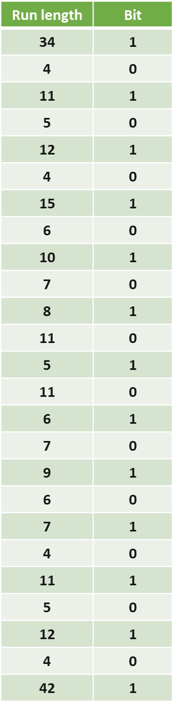
Uncompressed, this image is 256 bits (32 bytes) in size to store.
But notice, there are lots of pixels that have the SAME colour.
RLE (Run Length Encoding)
Using RLE, instead of storing each pixel individually, we can record a ‘run’ of pixels (how many the same) and the colour of that pixel
For example, at the start of the image there are 34 pixels of White
There are then 4 pixels of Black
Then 11 pixels of White again
This whole image can be recorded in a table like the one on the right:
1 | 1 | 1 | 1 | 1 | 1 | 1 | 1 | 1 | 1 | 1 | 1 | 1 | 1 | 1 | 1
1 | 1 | 1 | 1 | 1 | 1 | 1 | 1 | 1 | 1 | 1 | 1 | 1 | 1 | 1 | 1
1 | 1 | 0 | 0 | 0 | 0 | 1 | 1 | 1 | 1 | 1 | 1 | 1 | 1 | 1 | 1
1 | 0 | 0 | 0 | 0 | 0 | 1 | 1 | 1 | 1 | 1 | 1 | 1 | 1 | 1 | 1
1 | 1 | 0 | 0 | 0 | 0 | 1 | 1 | 1 | 1 | 1 | 1 | 1 | 1 | 1 | 1
1 | 1 | 1 | 1 | 1 | 0 | 0 | 0 | 0 | 0 | 0 | 1 | 1 | 1 | 1 | 1
1 | 1 | 1 | 1 | 1 | 0 | 0 | 0 | 0 | 0 | 0 | 0 | 1 | 1 | 1 | 1
1 | 1 | 1 | 1 | 0 | 0 | 0 | 0 | 0 | 0 | 0 | 0 | 0 | 0 | 0 | 1
1 | 1 | 1 | 1 | 0 | 0 | 0 | 0 | 0 | 0 | 0 | 0 | 0 | 0 | 0 | 1
1 | 1 | 1 | 1 | 1 | 0 | 0 | 0 | 0 | 0 | 0 | 0 | 1 | 1 | 1 | 1
1 | 1 | 1 | 1 | 1 | 0 | 0 | 0 | 0 | 0 | 0 | 1 | 1 | 1 | 1 | 1
1 | 1 | 0 | 0 | 0 | 0 | 1 | 1 | 1 | 1 | 1 | 1 | 1 | 1 | 1 | 1
1 | 0 | 0 | 0 | 0 | 0 | 1 | 1 | 1 | 1 | 1 | 1 | 1 | 1 | 1 | 1
1 | 1 | 0 | 0 | 0 | 0 | 1 | 1 | 1 | 1 | 1 | 1 | 1 | 1 | 1 | 1
1 | 1 | 1 | 1 | 1 | 1 | 1 | 1 | 1 | 1 | 1 | 1 | 1 | 1 | 1 | 1
1 | 1 | 1 | 1 | 1 | 1 | 1 | 1 | 1 | 1 | 1 | 1 | 1 | 1 | 1 | 1

Slide 24
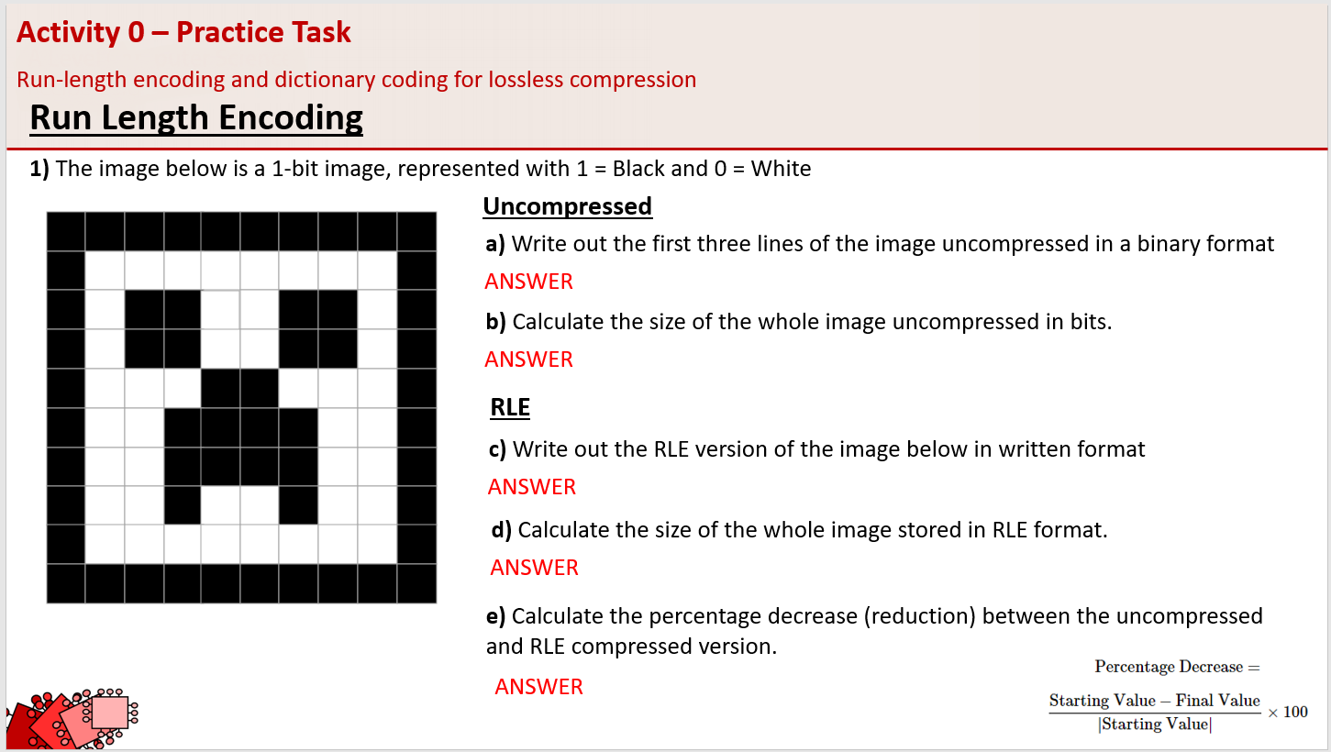
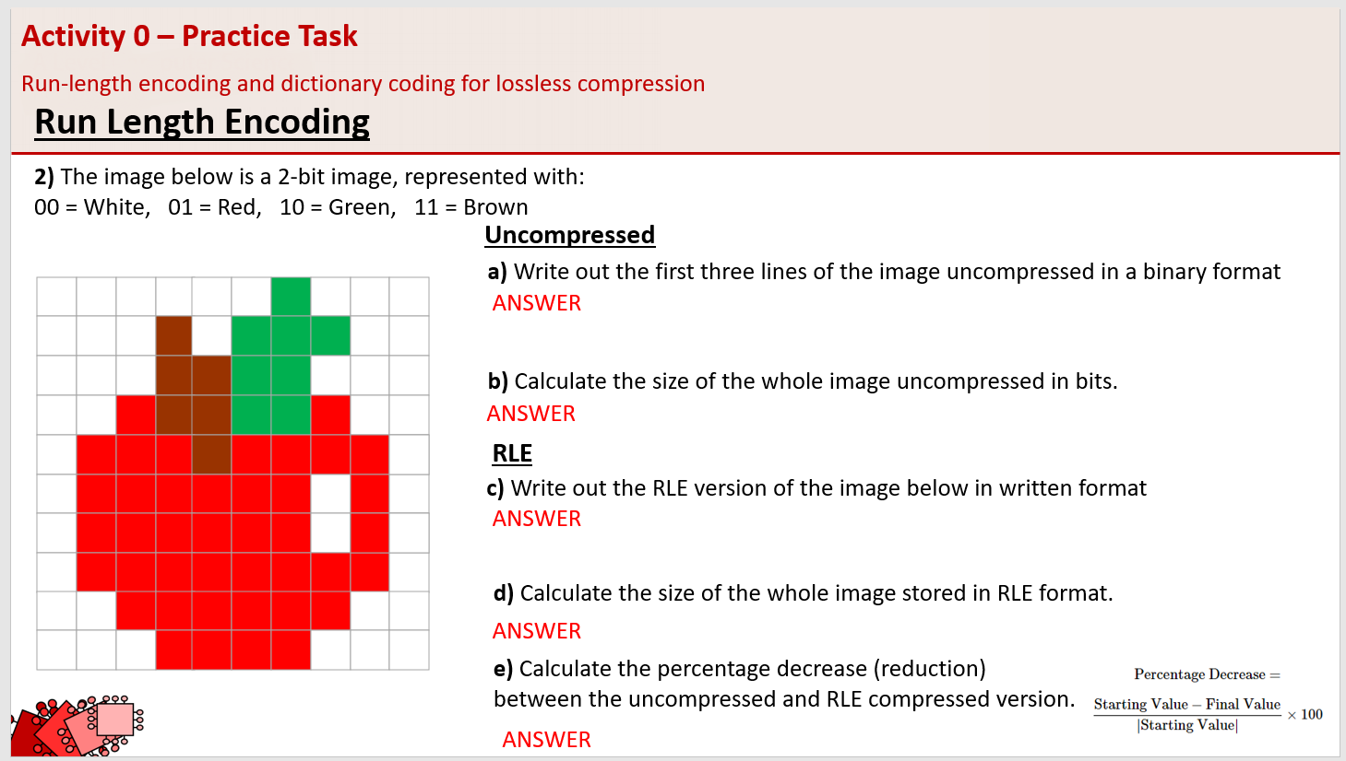
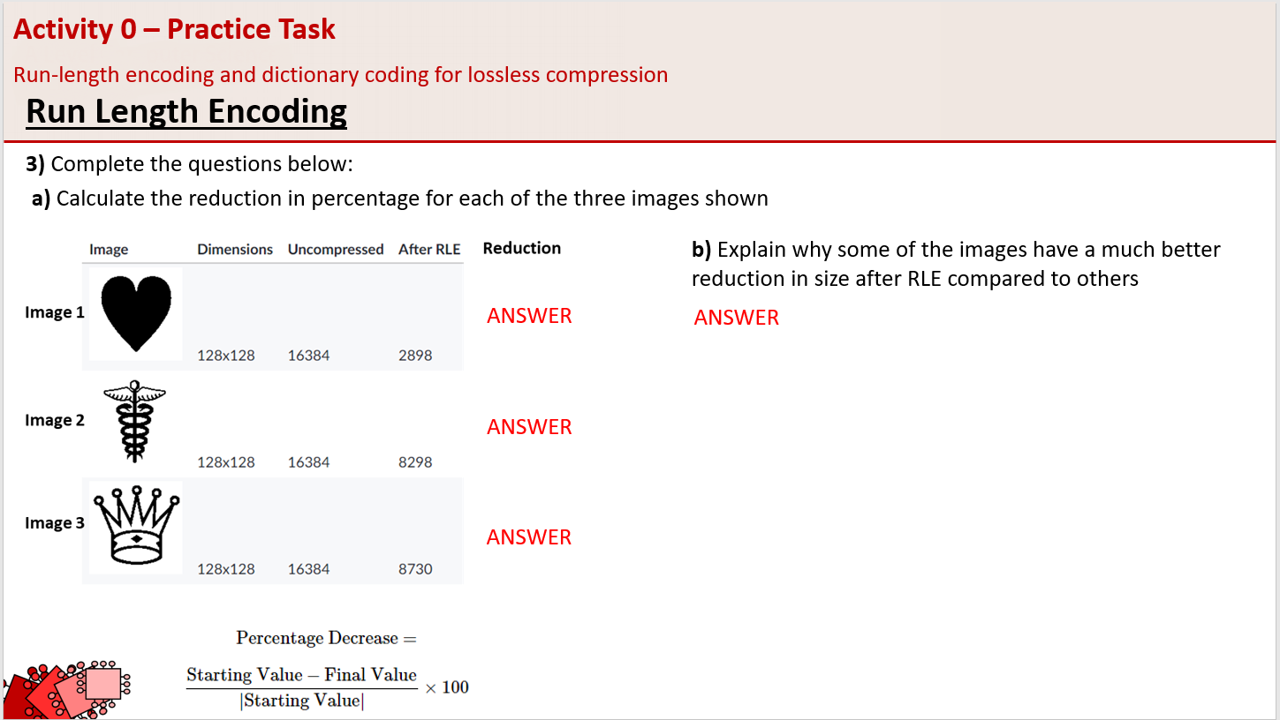
Activity
Go Microsoft Teams
Open Assignment ‘Activity 0 – Practice Task’
Complete slides 1-3
…

Slide 25

Activity 0 – Practice Task
Run-length encoding and dictionary coding for lossless compression
Run Length Encoding
1) The image below is a 1-bit image, represented with 1 = Black and 0 = White
Uncompressed
a) Write out the first three lines of the image uncompressed in a binary format
ANSWER
b) Calculate the size of the whole image uncompressed in bits.
ANSWER
RLE
c) Write out the RLE version of the image below in written format
ANSWER
d) Calculate the size of the whole image stored in RLE format.
ANSWER
e) Calculate the percentage decrease (reduction) between the uncompressed and RLE compressed version.
ANSWER

Slide 26
Activity 0 – Practice Task - ANSWERS
Run-length encoding and dictionary coding for lossless compression
Run Length Encoding
1) The image below is a 1-bit image, represented with 1 = Black and 0 = White
Uncompressed
a) Write out the first three lines of the image uncompressed in a binary format
1111111111 1000000001 1011001101 (30)
b) Calculate the size of the whole image uncompressed in bits.
100 bits
RLE
c) Write out the RLE version of the image below in written format
11B 8W 2B 1W 2B 2W 2B 1W 2B 1W 2B 2W 2B 1W 2B 3W 2B 3W 2B 2W 4B 2W 2B 2W 4B 2W 2B 2W 1B 2W 1B 2W 2B 8W 11B (72)
d) Calculate the size of the whole image stored in RLE format.
72
e) Calculate the percentage decrease (reduction) between the uncompressed and RLE compressed version.
28%

Slide 27
Activity 0 – Practice Task
Run-length encoding and dictionary coding for lossless compression
Run Length Encoding
2) The image below is a 2-bit image, represented with:
00 = White, 01 = Red, 10 = Green, 11 = Brown
Uncompressed
a) Write out the first three lines of the image uncompressed in a binary format
ANSWER
b) Calculate the size of the whole image uncompressed in bits.
ANSWER
RLE
c) Write out the RLE version of the image below in written format
ANSWER
d) Calculate the size of the whole image stored in RLE format.
ANSWER
e) Calculate the percentage decrease (reduction) between the uncompressed and RLE compressed version.
ANSWER

Slide 28
Activity 0 – Practice Task - ANSWERS
Run-length encoding and dictionary coding for lossless compression
Run Length Encoding
2) The image below is a 2-bit image, represented with:
00 = White, 01 = Red, 10 = Green, 11 = Brown
Uncompressed
a) Write out the first three lines of the image uncompressed in a binary format
00,00,00,00,00,00,10,00,00,00,00,00,00,11,00,10,10,10,00,00,00,00,00,11,11,10,10,00,00,00
b) Calculate the size of the whole image uncompressed in bits.
100 x 2 = 200 bits
RLE
c) Write out the RLE version of the image below in written format
6W, 1G, 6W, 1B, 1W, 3G, 5W, 2B, 2G, 5W, 1R, 2B, 2G, 1R, 3W, 3R, 1B, 4R, 2W, 6R, 1W, 1R, 2W,6R, 1R, 2W, 8R, 3W, 6R, 5W, 4R, 3W
d) Calculate the size of the whole image stored in RLE format.
64
e) Calculate the percentage decrease (reduction) between the uncompressed and RLE compressed version.
68%

Slide 29
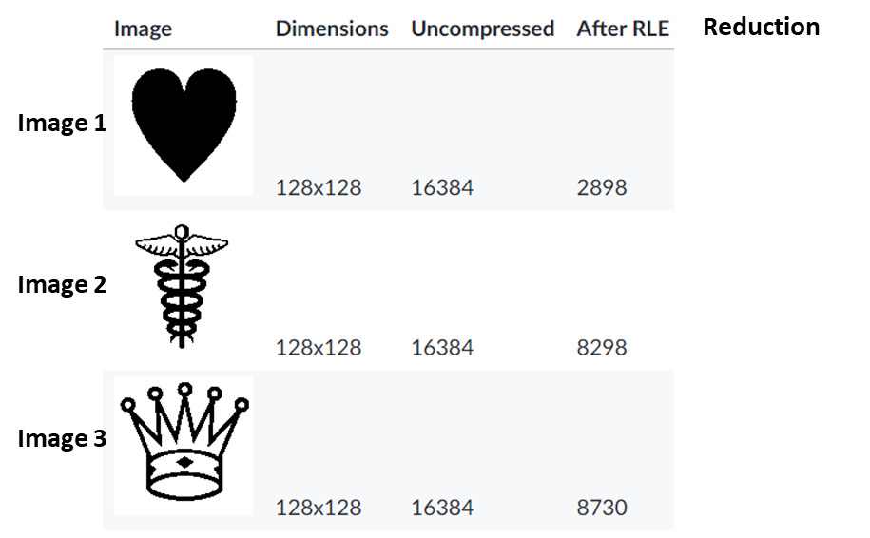
Activity 0 – Practice Task
Run-length encoding and dictionary coding for lossless compression
Run Length Encoding
3) Complete the questions below:
a) Calculate the reduction in percentage for each of the three images shown
b) Explain why some of the images have a much better reduction in size after RLE compared to others
ANSWER
ANSWER
ANSWER
ANSWER

Slide 30
Activity 0 – Practice Task - ANSWERS
Run-length encoding and dictionary coding for lossless compression
Run Length Encoding
3) Complete the questions below:
a) Calculate the reduction in percentage for each of the three images shown
b) Explain why some of the images have a much better reduction in size after RLE compared to others
82.3%
Image 1 has a lot of pixels of the same colour in a continuous runs of the same colour, so there are lot less values stored and compression is much higher.
Image 2 and 3 both have a lot more changes between colours/less runs of same colour, so the compression does not work as well.
49.4%
46.7%

Slide 31
Black and white means large runs of 0s and 1s
1 | 1 | 1 | 1 | 1 | 1 | 1 | 1 | 1 | 1 | 1 | 1 | 1 | 1 | 1 | 1
1 | 1 | 1 | 1 | 1 | 1 | 1 | 1 | 1 | 1 | 1 | 1 | 1 | 1 | 1 | 1
1 | 1 | 0 | 0 | 0 | 0 | 1 | 1 | 1 | 1 | 1 | 1 | 1 | 1 | 1 | 1
1 | 0 | 0 | 0 | 0 | 0 | 1 | 1 | 1 | 1 | 1 | 1 | 1 | 1 | 1 | 1
1 | 1 | 0 | 0 | 0 | 0 | 1 | 1 | 1 | 1 | 1 | 1 | 1 | 1 | 1 | 1
1 | 1 | 1 | 1 | 1 | 0 | 0 | 0 | 0 | 0 | 0 | 1 | 1 | 1 | 1 | 1
1 | 1 | 1 | 1 | 1 | 0 | 0 | 0 | 0 | 0 | 0 | 0 | 1 | 1 | 1 | 1
1 | 1 | 1 | 1 | 0 | 0 | 0 | 0 | 0 | 0 | 0 | 0 | 0 | 0 | 0 | 1
1 | 1 | 1 | 1 | 0 | 0 | 0 | 0 | 0 | 0 | 0 | 0 | 0 | 0 | 0 | 1
1 | 1 | 1 | 1 | 1 | 0 | 0 | 0 | 0 | 0 | 0 | 0 | 1 | 1 | 1 | 1
1 | 1 | 1 | 1 | 1 | 0 | 0 | 0 | 0 | 0 | 0 | 1 | 1 | 1 | 1 | 1
1 | 1 | 0 | 0 | 0 | 0 | 1 | 1 | 1 | 1 | 1 | 1 | 1 | 1 | 1 | 1
1 | 0 | 0 | 0 | 0 | 0 | 1 | 1 | 1 | 1 | 1 | 1 | 1 | 1 | 1 | 1
1 | 1 | 0 | 0 | 0 | 0 | 1 | 1 | 1 | 1 | 1 | 1 | 1 | 1 | 1 | 1
1 | 1 | 1 | 1 | 1 | 1 | 1 | 1 | 1 | 1 | 1 | 1 | 1 | 1 | 1 | 1
1 | 1 | 1 | 1 | 1 | 1 | 1 | 1 | 1 | 1 | 1 | 1 | 1 | 1 | 1 | 1
DISCUSSION:
What characteristics of the image make it suitable for run length encoding?

Slide 32
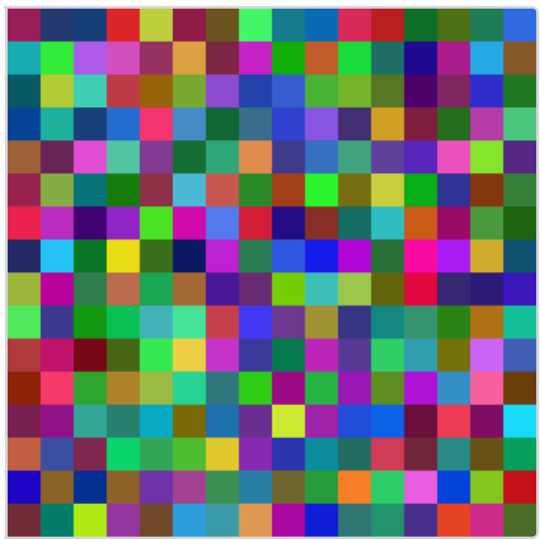


QUESTION – Would RLE be effective on this image? Why?
Have a look at this image carefully.
Every pixel in that icon is a different color, and there are no runs.
Run-length-encoding can't compress an image like that at all.
You might think that most pictures are not like this, but actually, in most photographs, if you zoom in, there are lots and lots of variations of different shades of colours that are NOT the same.

Slide 33
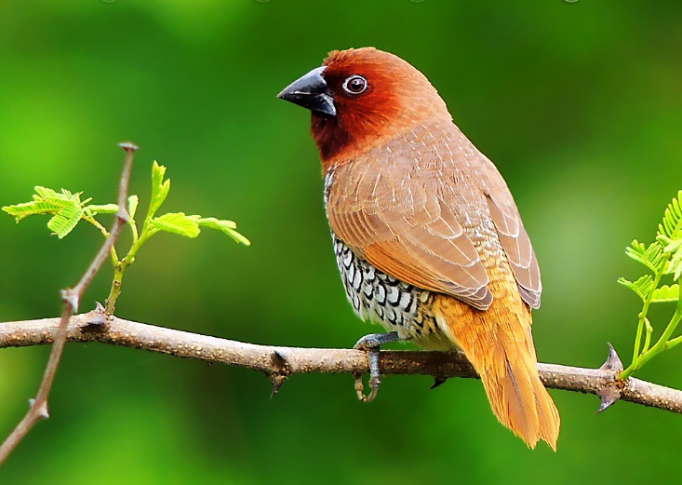
This icon would be referred to as a “1-bit colour” image.
24 bits needed for each pixel.
8 for red, 8 for green, 8 for blue.
1 | 1 | 1 | 1 | 1 | 1 | 1 | 1 | 1 | 1 | 1 | 1 | 1 | 1 | 1 | 1
1 | 1 | 1 | 1 | 1 | 1 | 1 | 1 | 1 | 1 | 1 | 1 | 1 | 1 | 1 | 1
1 | 1 | 0 | 0 | 0 | 0 | 1 | 1 | 1 | 1 | 1 | 1 | 1 | 1 | 1 | 1
1 | 0 | 0 | 0 | 0 | 0 | 1 | 1 | 1 | 1 | 1 | 1 | 1 | 1 | 1 | 1
1 | 1 | 0 | 0 | 0 | 0 | 1 | 1 | 1 | 1 | 1 | 1 | 1 | 1 | 1 | 1
1 | 1 | 1 | 1 | 1 | 0 | 0 | 0 | 0 | 0 | 0 | 1 | 1 | 1 | 1 | 1
1 | 1 | 1 | 1 | 1 | 0 | 0 | 0 | 0 | 0 | 0 | 0 | 1 | 1 | 1 | 1
1 | 1 | 1 | 1 | 0 | 0 | 0 | 0 | 0 | 0 | 0 | 0 | 0 | 0 | 0 | 1
1 | 1 | 1 | 1 | 0 | 0 | 0 | 0 | 0 | 0 | 0 | 0 | 0 | 0 | 0 | 1
1 | 1 | 1 | 1 | 1 | 0 | 0 | 0 | 0 | 0 | 0 | 0 | 1 | 1 | 1 | 1
1 | 1 | 1 | 1 | 1 | 0 | 0 | 0 | 0 | 0 | 0 | 1 | 1 | 1 | 1 | 1
1 | 1 | 0 | 0 | 0 | 0 | 1 | 1 | 1 | 1 | 1 | 1 | 1 | 1 | 1 | 1
1 | 0 | 0 | 0 | 0 | 0 | 1 | 1 | 1 | 1 | 1 | 1 | 1 | 1 | 1 | 1
1 | 1 | 0 | 0 | 0 | 0 | 1 | 1 | 1 | 1 | 1 | 1 | 1 | 1 | 1 | 1
1 | 1 | 1 | 1 | 1 | 1 | 1 | 1 | 1 | 1 | 1 | 1 | 1 | 1 | 1 | 1
1 | 1 | 1 | 1 | 1 | 1 | 1 | 1 | 1 | 1 | 1 | 1 | 1 | 1 | 1 | 1
Most photographs would be stored with 24-bit colour.
DISCUSSION:
What does 24-bit colour mean?
Significantly larger.
DISCUSSION:
What is the implication for file size?

Slide 34


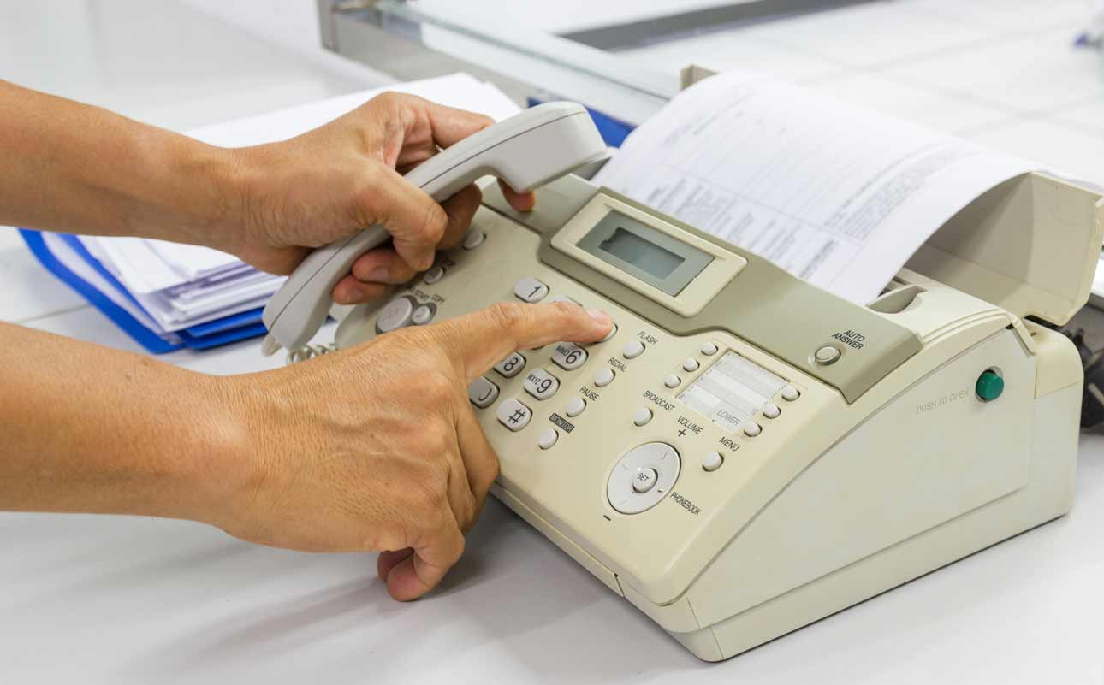
Uses for RLE
RLE compression was a very popular technique when most computer images were icons with limited color palettes.
These days, our images are more complex and don't contain as many runs of the same color.
Where is RLE used today?
Fax machines still use RLE for compressing the faxed documents, since they only need to represent black and white letters.
JPEG images do use RLE during a final stage of compression, but they first use a more complex algorithm to compress the photographic details.

