Slide 1



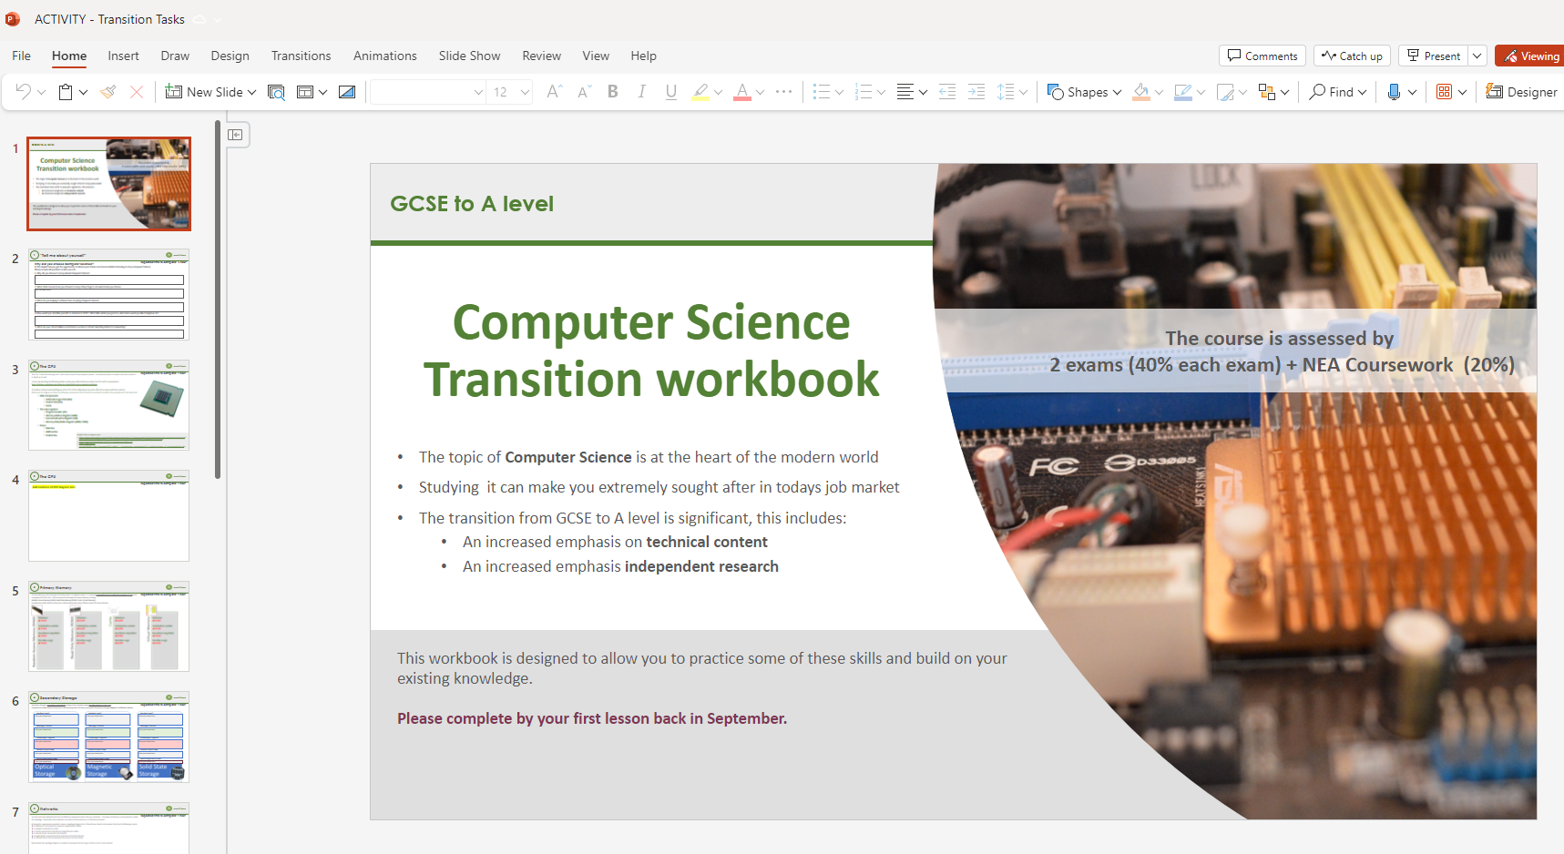
Independent Task
You also have a task/tasks to complete over the summer. This task must be handed in on your first lesson in September. Completing the task is part of your conditions of acceptance on the course.
Please complete following instructions below:
Task details:
Log in to Microsoft Teams
Select team
‘Y12 Computer Science’
Click on ‘Assignments’
Open assignment
‘ACTIVITY – Transition Tasks’
Complete slides
Your task is: A Level Computer Science
Run-Length Encoding (Taster Topic)
Complete the following slides based around
‘Run-Length Encoding’ covered in taster session.
These will normally be completed digitally using ‘Microsoft Teams’, but for today please complete on printed paper copies provided
This task should take 25 minutes. You should complete it in the post 16 study area.
Once complete, submit your task to Mr Gorvin
Deadline: Today Time: ASAP

Slide 2

Activity 0 – Practice Task
Run-length encoding and dictionary coding for lossless compression
Run Length Encoding
1) The image below is a 1-bit image, represented with 1 = Black and 0 = White
Uncompressed
a) Write out the first three lines of the image uncompressed in a binary format
b) Calculate the size of the whole image uncompressed in bits.
RLE
c) Write out the RLE version of the image below in written format
d) Calculate the size of the whole image stored in RLE format.
e) Calculate the percentage decrease (reduction) between the uncompressed and RLE compressed version.

Slide 3
Activity 0 – Practice Task
Run-length encoding and dictionary coding for lossless compression
Run Length Encoding
2) The image below is a 2-bit image, represented with:
00 = White, 01 = Red, 10 = Green, 11 = Brown
Uncompressed
a) Write out the first three lines of the image uncompressed in a binary format
b) Calculate the size of the whole image uncompressed in bits.
RLE
c) Write out the RLE version of the image below in written format
d) Calculate the size of the whole image stored in RLE format.
e) Calculate the percentage decrease (reduction) between the uncompressed and RLE compressed version.

Slide 4
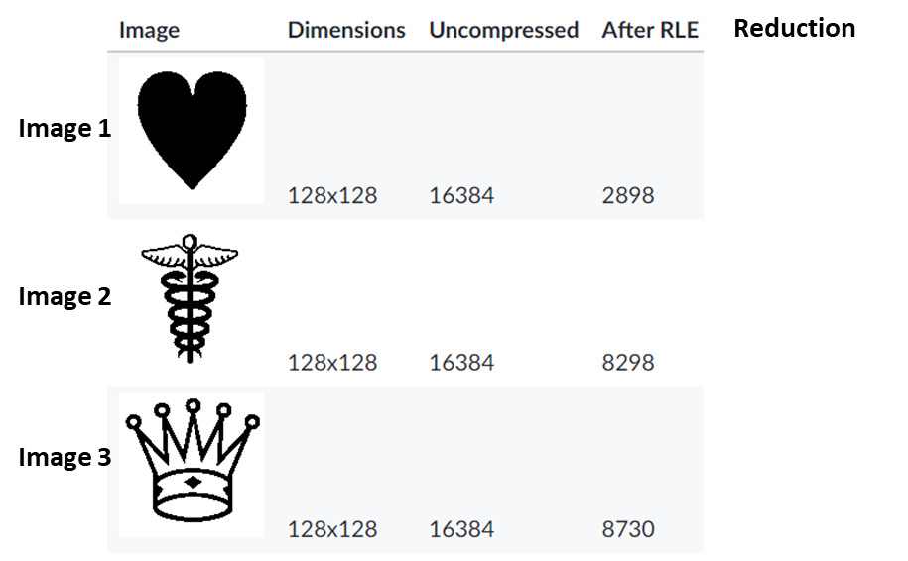
Activity 0 – Practice Task
Run-length encoding and dictionary coding for lossless compression
Run Length Encoding
3) Complete the questions below:
a) Calculate the reduction in percentage for each of the three images shown
b) Explain why some of the images have a much better reduction in size after RLE compared to others
ANSWER
ANSWER
ANSWER

Slide 5
Activity 0 – Practice Task
Run-length encoding and dictionary coding for lossless compression
Run Length Encoding
4) Create your own 1-bit image, then write out the RLE version of the image after it has been compressed
ANSWER

