Slide 1

Level 3 core maths

Slide 2
What is taught…
PAPER 1 (calculator) (60 marks – 90 minutes)
Analysis of data
Maths for personal finance
Estimation
PAPER 2 (calculator) (60 marks – 90 minutes)
Critical analysis of given data and models
Critical path analysis
Expectation
Cost benefit analysis

Slide 3
Starter:
Estimate the length of time you spend travelling to and from work in a year.

Slide 4
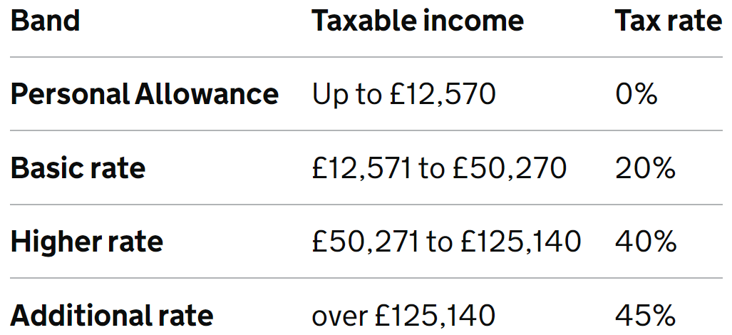
Income tax and personal allowances
How much Income Tax you pay in each tax year depends on:
how much of your income is above your Personal Allowance
how much of your income falls within each tax band
The standard Personal Allowance is £12,570, which is the amount of income you do not have to pay tax on.
The money raised from taxes goes to pay for essential products and services. Schools, emergency services, roads and healthcare are some of the major things we benefit from by paying taxes.

Slide 5
Worked example:
Your turn:
Calculate the amount of income tax a person pays if he/she earns £45 400 per year.
Calculate the amount of income tax a person pays if he/she earns £39 500 per year.

Slide 6
Worked example:
Your turn:
Calculate the amount of income tax a person pays if he/she earns £67 400 per year.
Calculate the amount of income tax a person pays if he/she earns £59 300 per year.

Slide 7
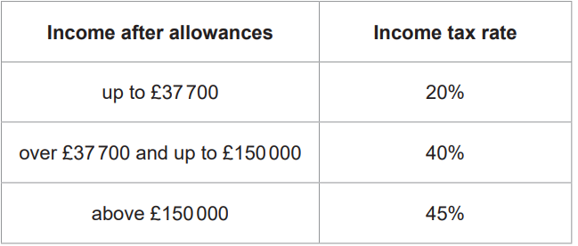
Practice…
Calculate the amount of income tax for the following gross salaries:
Marketing director: £80 411
Public relations professionals: £34 168
Advertising accounts manager and creative director: £42 531
Information technology and telecommunications director: £69 409
IT business analysts, architects and system designers: £47 948
The standard personal allowance for 2022–2023 is £12570

Slide 8
Answers…
Calculate the amount of income tax for the following gross salaries:
Marketing director: £80 411 £19596.40
Public relations professionals: £34 168 £4319.60
Advertising accounts manager and creative director: £42 531 £5992.20
Information technology and telecommunications director: £69 409 £15195.60
IT business analysts, architects and system designers: £47 948 £7075.60
The standard personal allowance for 2022–2023 is £12570

Slide 9
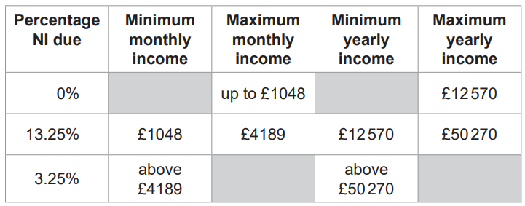
National insurance
National Insurance contributions are a tax on earnings and self-employed profits paid by employees, employers and the self-employed. They can help to build your entitlement to certain benefits depending whether you are employed or self-employed, such as the State Pension and Maternity Allowance.
You pay mandatory National Insurance if you’re 16 or over and are either:
an employee earning above £242 a week
self-employed and making a profit of more than £12,570 a year

Slide 10
Worked example:
Your turn:
Calculate the amount of income tax a person pays if he/she earns £45 400 per year.
Calculate the amount of income tax a person pays if he/she earns £39 500 per year.

Slide 11
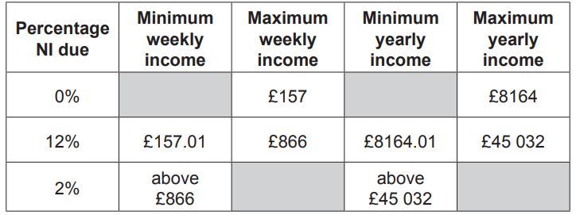
Practice…
Calculate the amount of National Insurance for the following gross salaries:
Marketing director: £80 411
Public relations professionals: £34 168
Advertising accounts manager and creative director: £42 531
Information technology and telecommunications director: £69 409
IT business analysts, architects and system designers: £47 948

Slide 12
Answers…
Calculate the amount of National Insurance for the following gross salaries:
Marketing director: £80 411 £5131.74
Public relations professionals: £34 168 £3120.48
Advertising accounts manager and creative director: £42 531 £4124.04
Information technology and telecommunications director: £69 409 £4911.70
IT business analysts, architects and system designers: £47 948 £4482.48

Slide 13
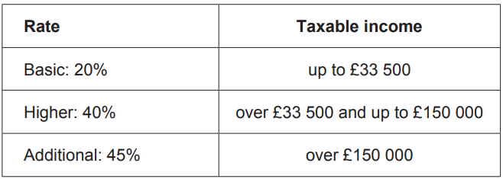
Plenary…
Use Income Tax and National Insurance 2017–2018 in the Preliminary Material. Vikki is thinking about returning to work after having a baby. Her employer offers her a contract for three days a week with a gross salary of £15 800 per year.
She will have to pay for nursery and travelling costs for each of the three days.
Nursery £32 per day
Travel £7 per day
Vikki will have four weeks’ holiday each year.
She will have no nursery or travel costs in these weeks.
She pays income tax and National Insurance but has no other deductions.
She has a personal tax allowance of £11 500
Vikki works out her average monthly net pay after paying the nursery and travel costs.
She says,
“I will still have more than £700 per month left of my net pay.”
Is she correct?
You must show your working.
The standard personal allowance for 2017–2018 is £11 500

