Slide 1
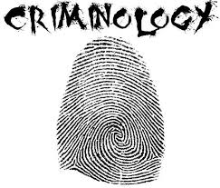
Year 12 Criminology Taster Session 2025
Mrs Osborn
eosborn@coombedean.co.uk

Slide 2
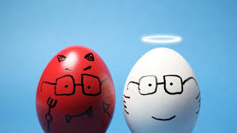
Discuss with the person next to you
Do you think people are born evil?
Can we always control ourselves?
Be prepared to explain your thoughts
Notes:
7 mins

Slide 3
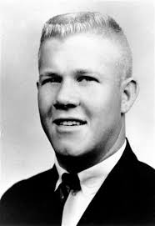
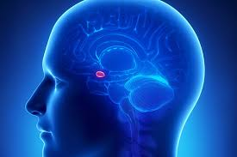
Charles Whitman: Climbed the clock tower in the university of Texas in 1966 & opened fire with a shotgun for 90 minutes.
He killed 14 people before he was shot by police
It was later discovered he had first, killed his mother and wife
He left a note begging for his brain to be scanned as he felt something wasn’t right
Do you think he should have gone to prison?

Slide 4

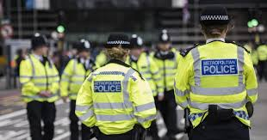
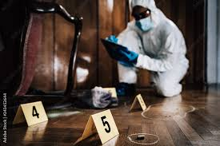
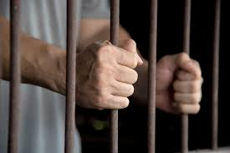
What will you study?
Unit 1: Controlled Assessment (8 hours) | Unit 2: External exam | Unit 3: Controlled Assessment (8 hours) | Unit 4: External exam
The changing awareness of crime Hidden crimes Crime statistics Media reporting of crime Campaigns | Theories of criminality Biological & psychological factors in explaining crime and how these are used to reduce crime. | From crime scene to courtroom The role of agencies in investigations Investigative techniques used The consequences of investigations not being accurate. | Crime and Punishment Different agencies in the criminal justice system, what they do and how effective they are. Processes for law making
Notes:
5 mins

Slide 5
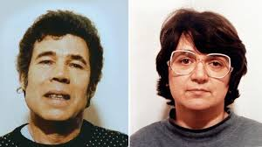
Fred West
Read through the case study, highlight possible reasons for his crimes
Turn and Talk: Was Fred evil?
Notes:
https://www.youtube.com/watch?v=BvGmb6VR8_g
Hand out the case – ask students to highlight possible reasons for the crimes and write a short conclusion why they think he might have done it.

Slide 6


Independent Task
You also have a task/tasks to complete over the summer. This task must be handed in on your first lesson in September. Completing the task is part of your conditions of acceptance on the course.
The task will be available on the school website from today.
Task details:
Please see attached sheet
Your task is:
Read through the case study of Fred West, highlight possible reasons for his crimes
Write a short summary on why you think Fred may have committed these crimes.
This task should take 25 minutes. You should complete it in the post 16 study area or P10.
Hand your finished task in to the office with your name clearly marked on it.
Deadline: Today Time: 3:00 eosborn@coombedean.co.uk

Slide 7
Year 12 criminology student advice:
What advice would you give to a Year 12 student at the start of their A Level criminology journey?
make good notes
Actually listen from the start
Keep on-top of work otherwise it catches up to you
Organise your notes into sections so that you know which Act is which.
Enjoy it
Keep up with workload but other than that enjoy
Making sure you keep on top of your work.
revise early on and condense your notes after each lesson, it will help massively when it comes closer to exams
Make sure to keep on top of posh notes and homework and have good time keeping
Watch the documentaries in your own time, it helps!

Slide 8

Summer work:
TASK 1:
What is crime? (examples)
What is deviance? (examples)
Choose one type of crime to research (honour, hate, domestic violence, white collar, state, moral, technological crime).
Include:
-Definition
-Typical Offender
-Typical Victim
Find an example or case study of this crime.
Include statistics about this crime (e.g. how many victim? Are incidences increasing?)
What are some reasons that someone may not want to report this crime if they are a victim?
TASK 2: Find a poster of a crime campaign. Explain why it is a good poster. What about It makes it convincing?
TASK 3: Research a criminal/killer of your choice. Consider what factors may have led to their crimes. Include details of their background and possible triggers.
Be ready to hand in and discuss during the first lesson in September.
ndulson@coombedean.co.uk

Slide 9
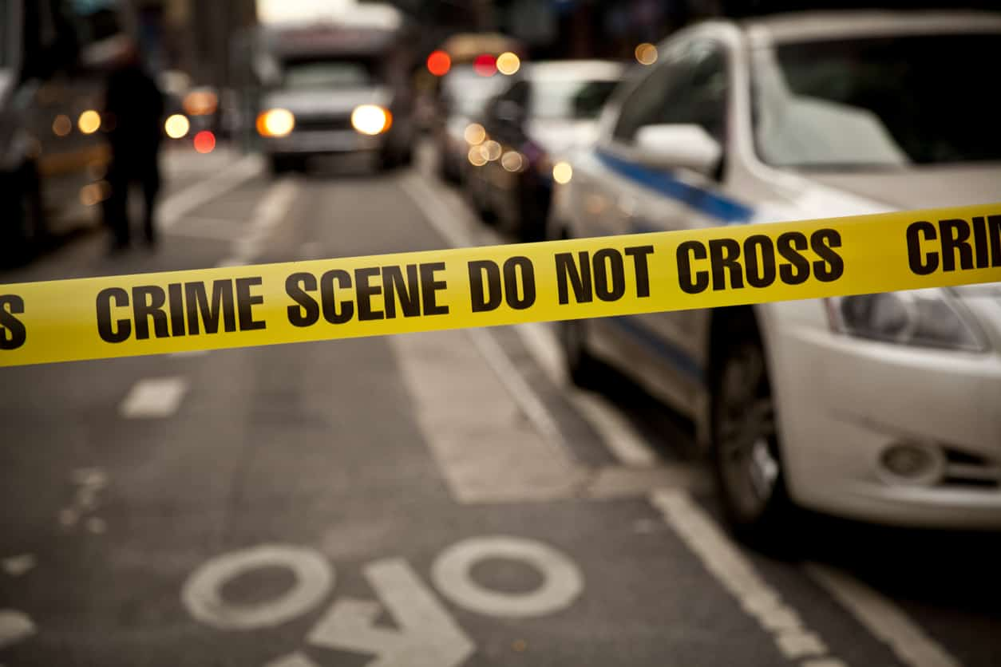
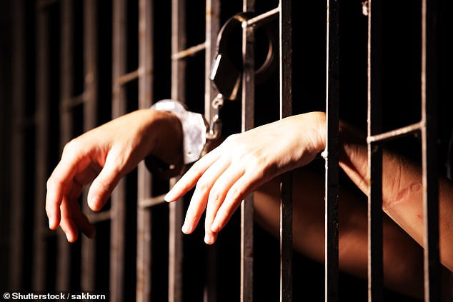
Criminology Watch List
Watching List - Criminology
Any documentaries, including Panorama, Louis Theroux, Stacey Dooley, Mind of a Murderer etc
Black Mirror series (Netflix)
Goodfellas
The Godfather (part 2 is the best)
Life and Deathrow (BBC)
McMafia (previously BBC i-player)
Freedom Writer’s Diary
Dangerous Minds
Chernobyl (drama)
When They See Us (Netflix)
White House Farm Murders (Netlfix)
TIME (BBC)
Making a murderer (Netflix)
LEGEND
Worlds Toughest Prisons (Netflix)
Tiger King
The Society (Netflix)
Blood Diamond
Ted Talks/Crime/Criminal Justice
Orange is the New Black (Netflix)
The Innocence Files (Netflix)
Cold Case Files (Netflix)
I Am A Killer (Netflix)
When They See Us Now – Oprah Winfrey (Netflix)
The Stanford Prison Experiment (Youtube)
The Push – Derren Brown (Netflix)
MacIntyre Undercover: The Chelsea Headhunters (Youtube)
The Shawshank Redemption
The Green Mile
24 Hours in Police Custardy (All 4)

Slide 10
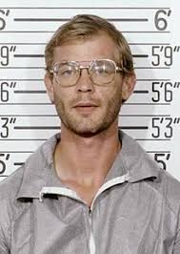
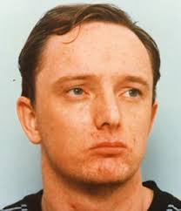
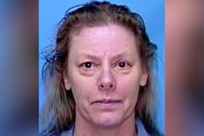
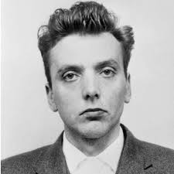
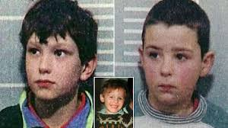
Jeffrey Dahmer
Robert Napper
Here are just some ideas – you can choose your own criminal
Ian Brady
Aileen Wuornos
John Venables – Robert Thompson

