Slide 1
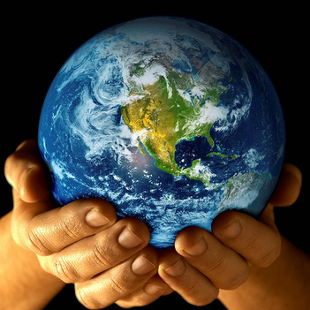
Geography A Level Introduction

Slide 2
Paper 1 30% | Paper 2 30%
A: Tectonic processes and hazards Dynamic landscapes 16/105 15% of paper | A: Superpowers Dynamic places 16/105 15% of paper A: Globalisation Dynamic places 16/105 15% of paper
B Coastal Landscapes Landscape systems processes and change 40/105 38% of paper | B: Regnerating places Shaping Places 35/105 33% of paper
C: Water cycle and insecurity Physical systems and sustainability C: Energy and carbon cycles Physical systems and sustainability 49/105 46% of paper (23% each) | C: Migration, Identity and Sovereignty Global development and connections 38/105 36% of paper
The largest % of the marks come from papers 1 and 2.
Worth 60% of your A level.

Slide 3
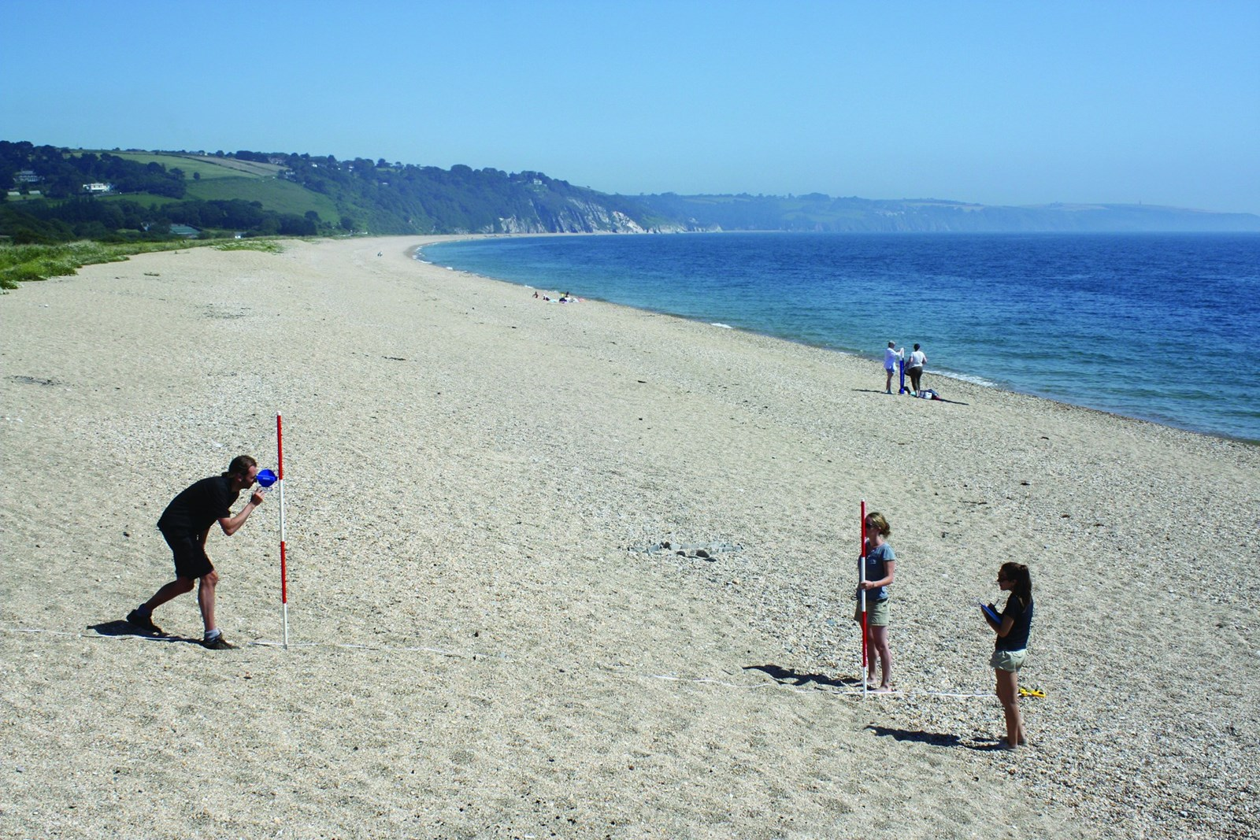
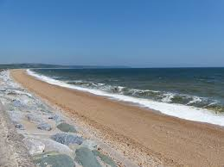
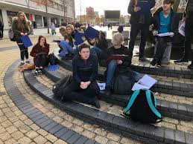
Unit 4
NEA 20%
Non-examined assessment
5,000+ word ‘coursework’
Independent investigation/enquiry
Your choice what to study

Slide 4
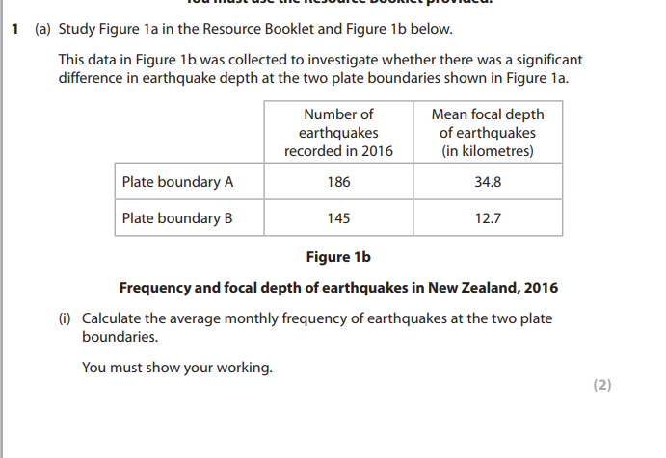
Physical paper Questions
(b) Assess the reasons why some communities are more vulnerable than others to tectonic hazards. (12) (1.5 pages)
Explain the physical processes that affect the rate of coastal recession. (6)
(d) Evaluate the view that hard engineering approaches to coastal management produce more winners than losers. (20) 3 pages
Explain why the price of water varies globally. (8)

Slide 5
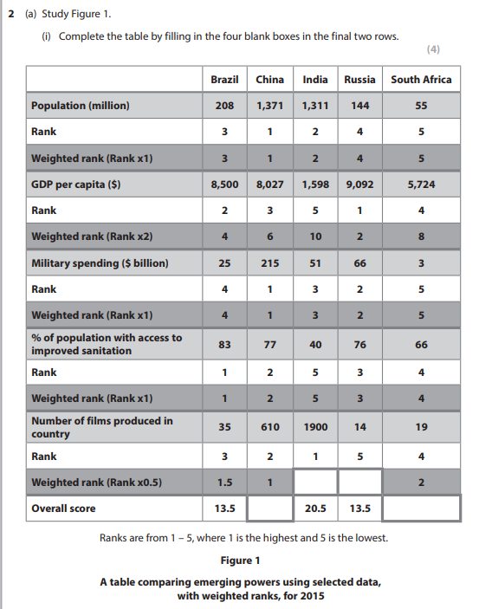
Human Questions
(a) Explain one reason why the global shift of industry has had negative impacts on some people in the developed world. (4)
Assess the view that Figure 1 gives an accurate summary of the relative strength of these emerging powers. (12)
(ii) Suggest reasons why perceptions of living in an inner-city area, such as in London, may vary. (6)
Evaluate the view that economic development always has negative consequences for minority groups. (20)

Slide 6
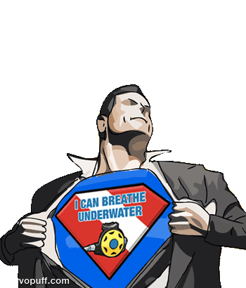
Superpower Geographies
Question 1:
What is a superpower?
Notes:
Relevance
To be adapted for Edexcel, A-Level unit 3, topic 4 (Superpower geographies) An introduction to superpowers. This presentation will ask who the superpowers are and their power has developed over time.
Objectives
To understand that the concept of a ‘superpower’ has developed to include economic, cultural, military and political influence
To appreciate that the patterns of global power change over time, as illustrated by the rise of the BRICs and non-state superpowers
Outcomes
To define the term ‘superpower’
To give examples of superpowers in the past, present and future.
To be able to describe the capabilities of named superpowers and explain what makes them a superpower
This presentation was given by Dr Alasdair Pinkerton, Lecturer in Human Geography (Royal Holloway, University of London), at the RGS-IBG A2 study day on 15 October 2012.

Slide 7
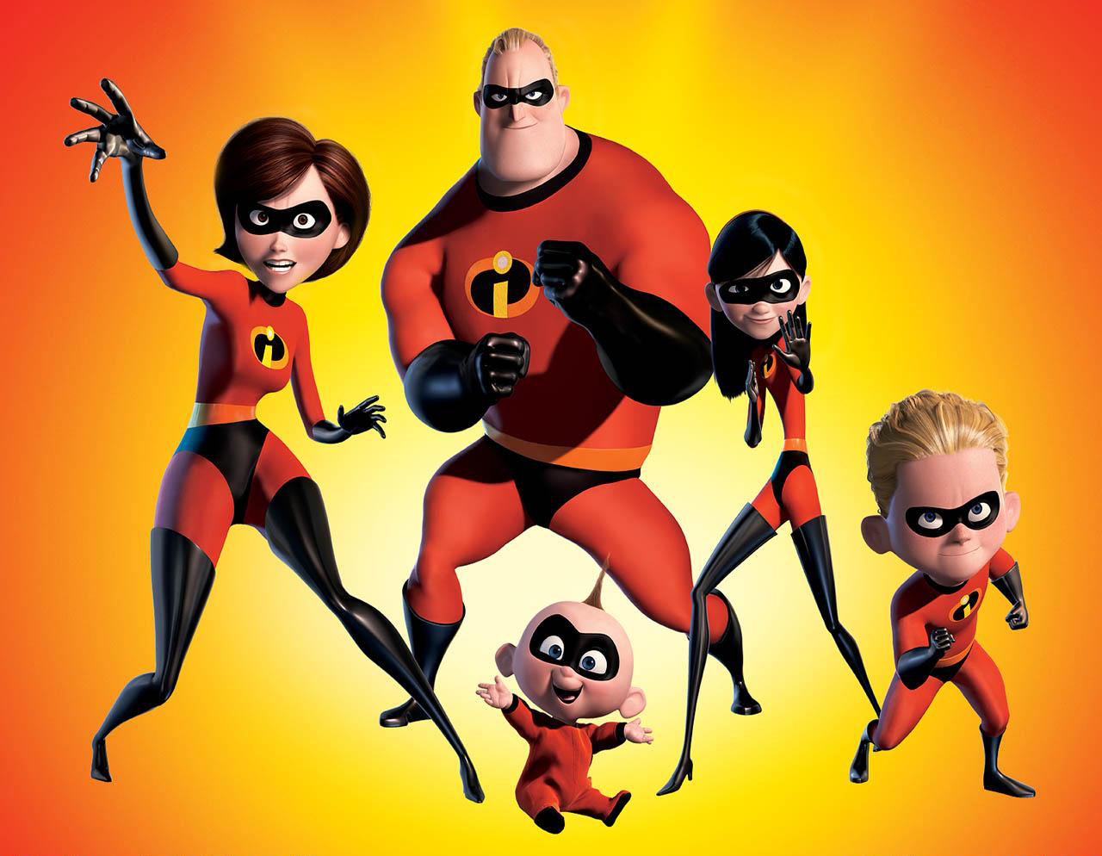
What is a Superpower?
“Superpower refers to a nation with the means to project its power and influence anywhere in the world, and to be a dominant global force.” This demands huge resources, so true superpowers are rare.
Emerging Superpower:
An emerging power is a term used by academics as recognition of the rising, primarily economic, influence of a nation - or union of nations - which has steadily increased their presence in global affairs.
Notes:
Former: UK, USSR
Current: USA
Emerging: Russia, Japan, China, Brazil, EU India

Slide 8
What is a superpower?
Read the definitions of a superpower, an emerging power, and a regional power.
Put the 19 countries below into an order of Global significance and power based upon your own geographical knowledge. GUESS!
Superpower Emerging power, Regional power Has little power.
The 20 countries
Australia
Egypt
South Africa
Mexico
Turkey
Nigeria
USA
Saudi Arabia
Iran
UK
Italy
Germany
France
Russia
China
Brazil
North Korea
Indonesia
Japan
India

Slide 9
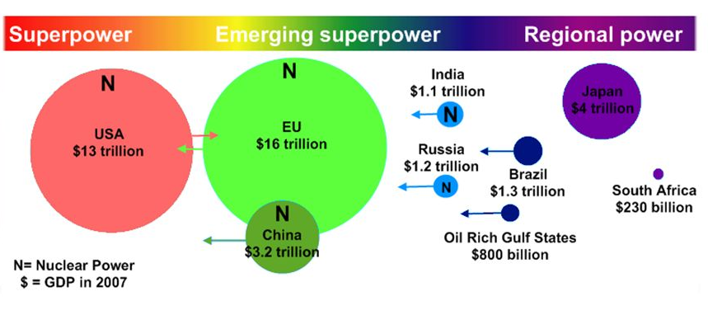
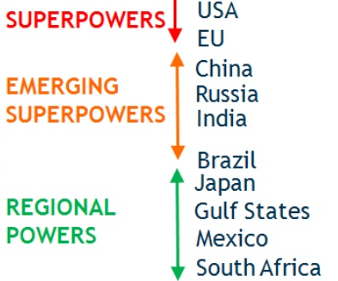
Two separate versions of published categorisations of power status but they both say the same thing essentially
Now write a list of 7 things that could be used to measure this position.

Slide 10
Write a list of 7 things that could be used to measure whether a country was a superpower, emerging power or regional power.
I will ask for contributions…..

Slide 11
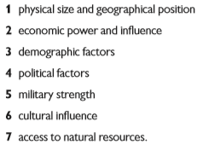
These are the 7 characteristics used to measure superpower status
For each one, write down why it is important for superpowers

Slide 12
Superpower ‘building blocks’
An alternative and simpler way of considering these individual elements was proposed by Dunn.
Why does it look like this?

Slide 13
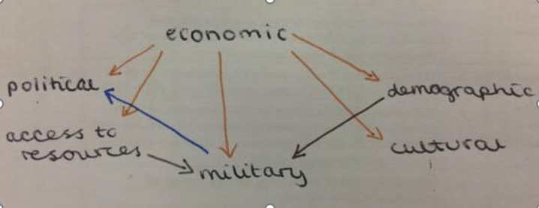
Can you write the pillars down and make connections between them?​

Slide 14
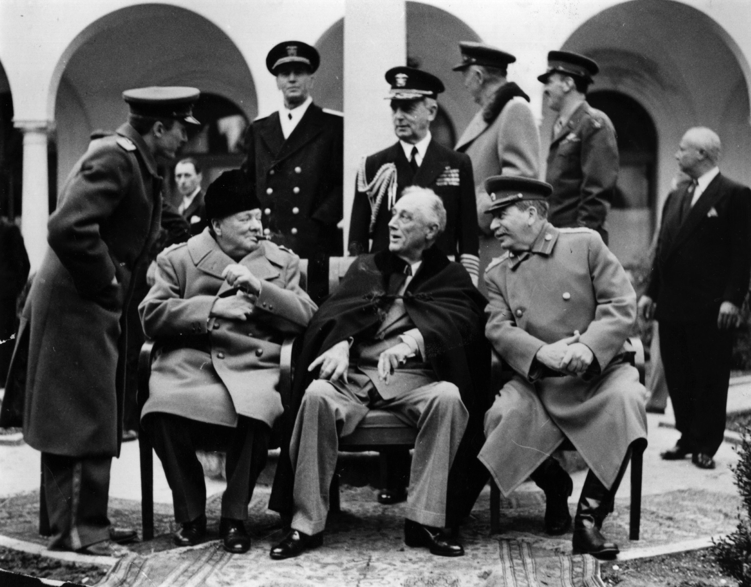
Winston Churchill
Prime Minister, UK
Franklin D Roosevelt
President, US
Joseph Stalin
Premier, USSR
Who are these people?!
Notes:
Image: These three gentlemen represent the three allied ‘superpowers’ that William Fox was referring to in 1944. From left to right: Winston Churchill (Prime Minister, UK), Franklin D Roosevelt (President, US) and Joseph Stalin (Premier, USSR).
These three men met at the Yalta conference in 1945 (Yalta is near the Black Sea in what is the Ukraine today and in 1944 was the USSR) to effectively discuss the future of the world – how they were going to rebuild it after World War II. This is the creation of a new global order, in which the global superpowers were defining themselves.

Slide 15

Cold War
and Two Superpowers
Notes:
The Cold War, stretched roughly from 1945 until 1991, and involved two superpowers – the USA and USSR
The Cold War created much of the 20th Century. This was one of the most important geographical events in many students’ parents’ and grandparents’ lifetimes. It totally transformed the way in which the world thought about geography.

Slide 16
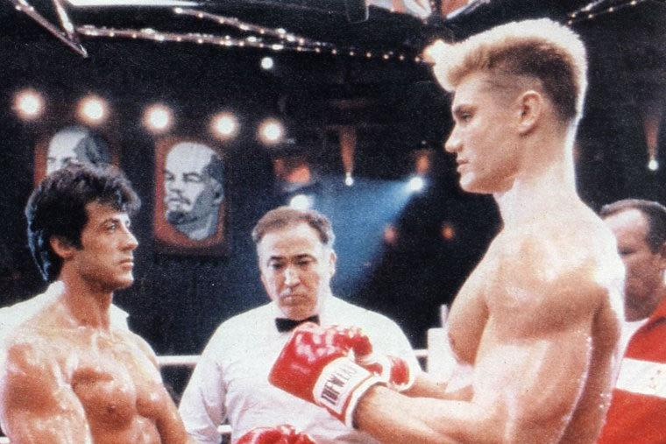
Cold War and Two Superpowers
Economic superpowers – trade and finance
Military superpowers – nuclear weapon states
Political superpowers – rival global ideologies
Culture superpowers– public diplomacy and ‘soft power’
Rocky IV (1985)
Notes:
Image: A still image from ‘Rocky IV’ (1985), this is representative of the Cold War. The USSR boxer on the right is fighting the US boxer on the left. A battle between the US and the USSR, this expressed the Cold War tensions between the world’s two superpowers in a sporting arena.
Question: What do we mean by ‘superpower’ when we refer to the US and the USSR in the context of the Cold War?
Economic superpowers – Dominated global trade and finance
Military superpowers – Possessed and seemed to be prepared to use nuclear weapons against one another
Political superpowers –Represented their own very clear and distinct political ideologies (US capitalism versus USSR communism)
Cultural superpowers – Exported various cultural ideas to their respective ‘spheres of influence’ (the geographical area that was loosely allied with them)
Key terms: Soft power is a capacity possessed by those countries that are very effective as sharing their ideas, cultural values and societal norms with other countries. It differs from ‘hard’ power, which involves the use of military hardware (bombs, tanks, nuclear deterrents) to exert influence.
Public diplomacy involves politicians and diplomats engaging directly with you, the public, generally through culture and the media (films, radio, advertising, social media). Governments may seek to influence their own nation’s public or they may try to capture the ‘hearts and minds’ of another nation’s public. This differs from ‘formal’ diplomacy which takes place between politicians and diplomats alike
Read more about ‘public diplomacy’ and ‘soft power’ (in the context of the Olympics, especially the Falkland Islands) at: http://www.geographyinthenews.rgs.org/member/newscasestudies/article/?id=1791

Slide 17
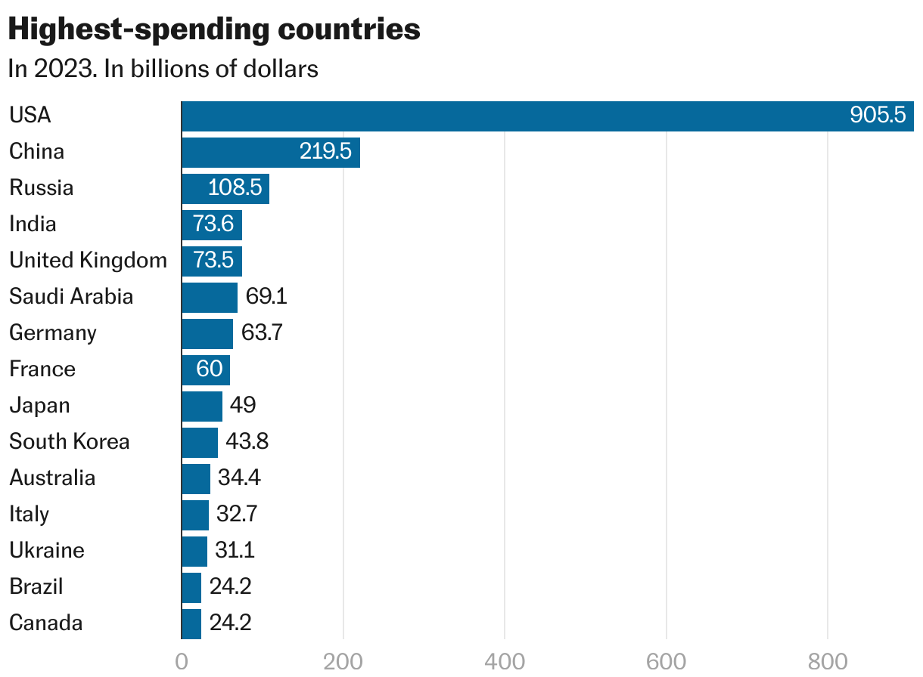
Beyond the Cold War: Rising Powers?
Military expenditure
(US$ Billions)
Describe the graph
What are the potential issues of this? Consider a range of counties
To what extent ss this an important aspect of being a superpower?
Notes:
Image: Bar chart comparing military expenditure (US$ Billions) of the US, China, Russia and India in 2008 (blue) and 2011 (red). This is a popular measure of hard power.
Interactive: Ask students to describe the patterns shown in the bar chart. Encourage them to think in relative (%age) terms, as well as in terms of absolute (US$ Billions) increases. For example, India’s growth is particularly great when considered in relative terms. Can they suggest how this might implicate the future balance of world power.
How would we measure declining and rising power worldwide? Perhaps by comparing military expenditure (hard power)
The US still has a very large (an increasing) military expenditure, but the BRICs have rapidly rising military expenditures.

Slide 18
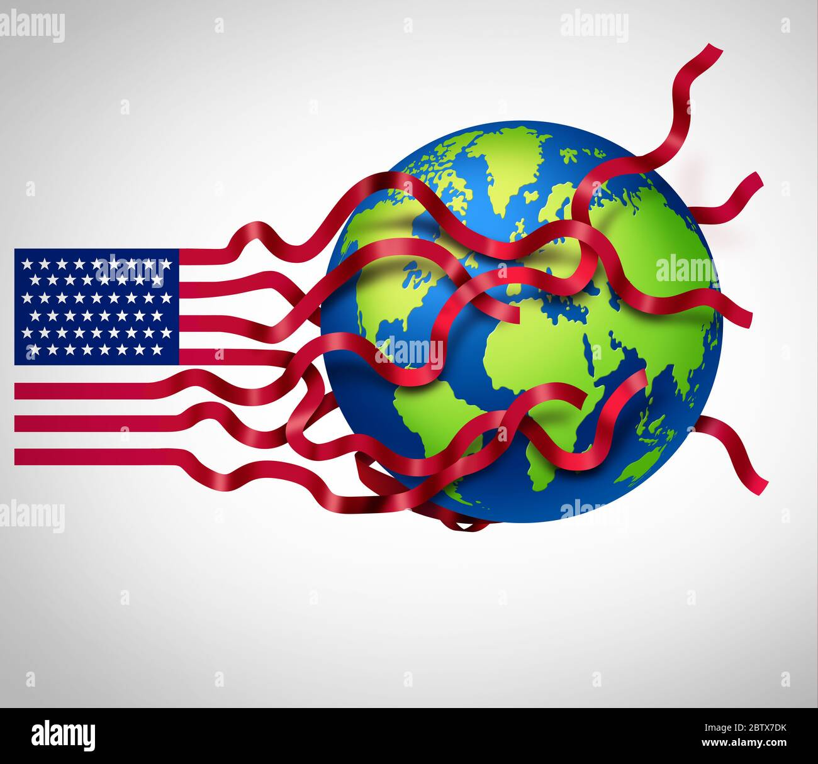
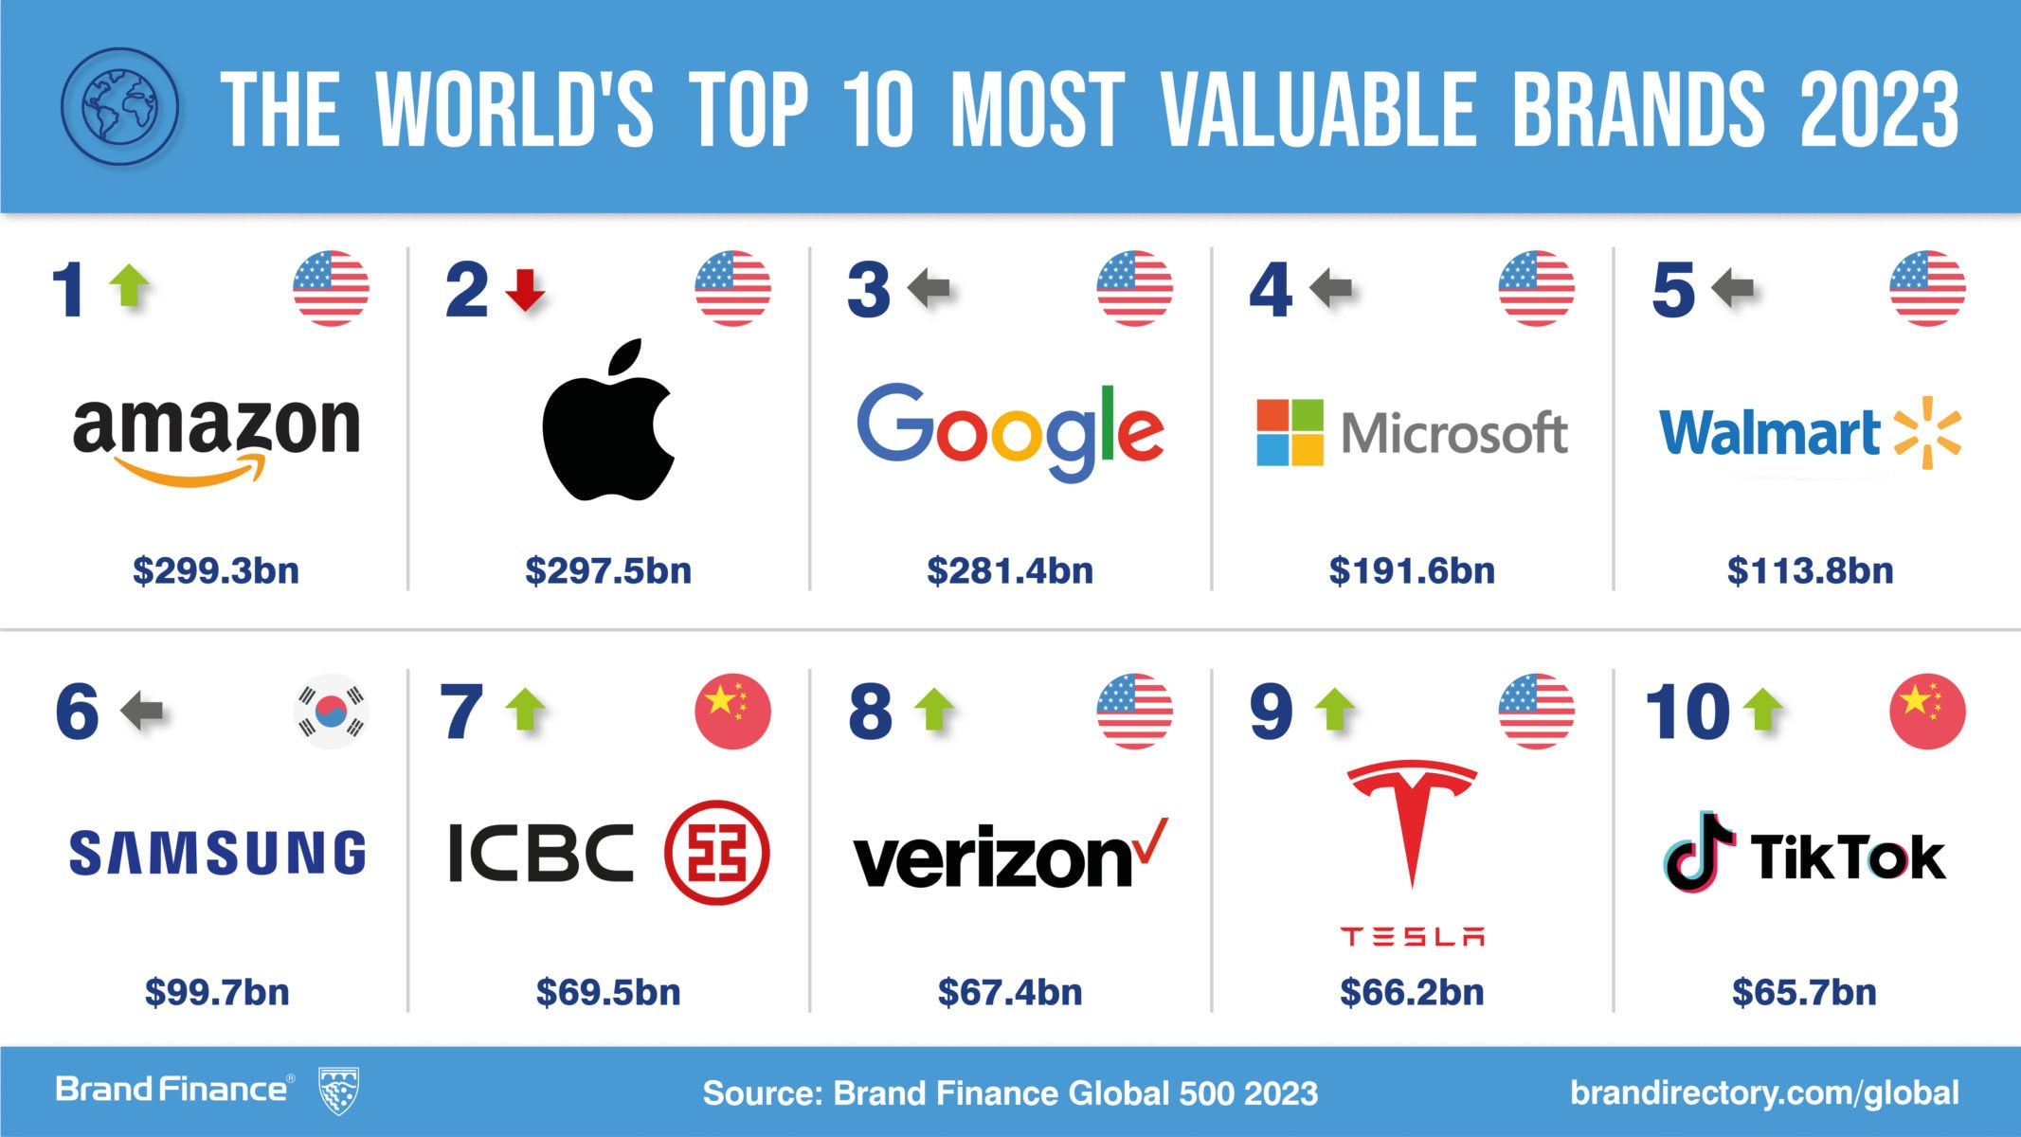

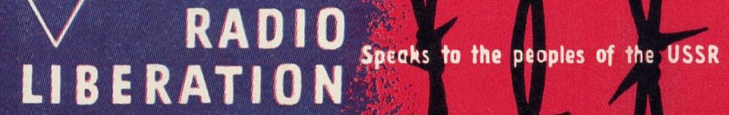
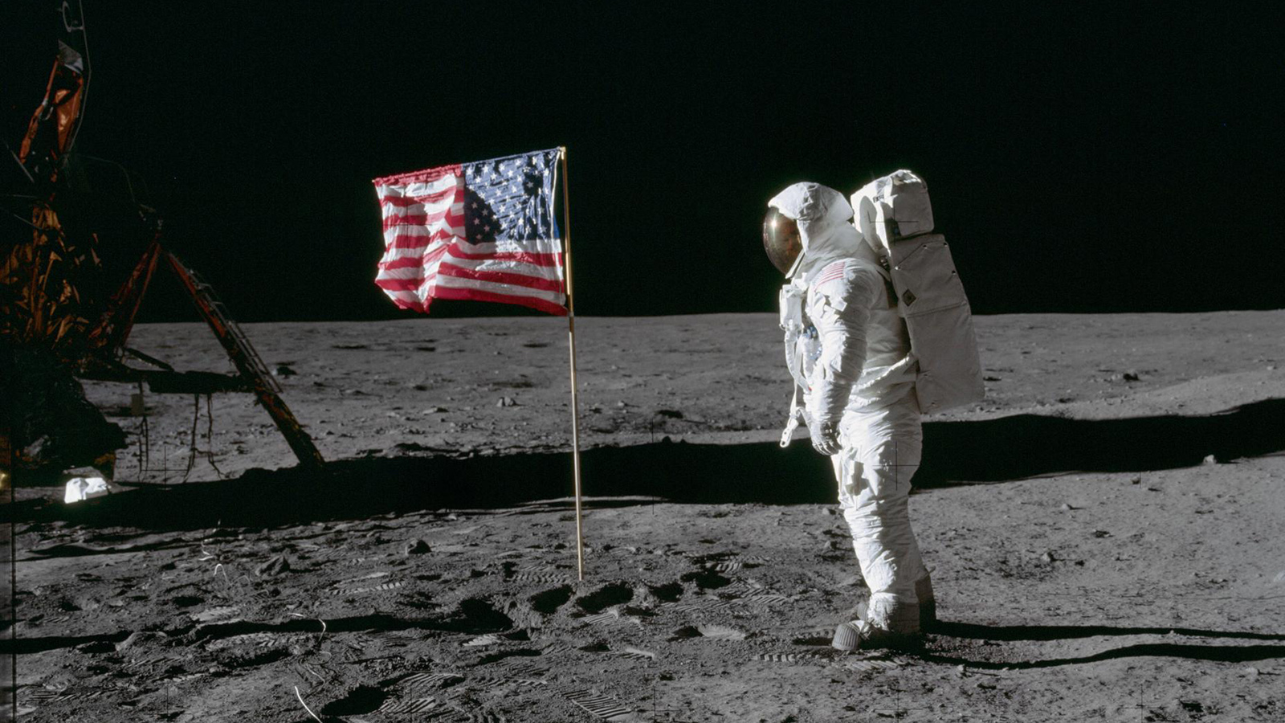
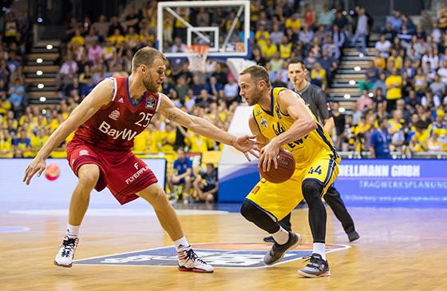
The US as a Soft Superpower
Look at the images;
What is soft power?
To what extent do you think this is important?
Is hard power or soft power more important? Why?
Notes:
US influence around the world was made not just through military and formal diplomacy, but also through ‘soft power’ – through movies, radio and sport. The film industry sold US ideas and culture around the world.
Image 1: Charlton Heston as Moses in the 1956 film ‘The Ten Commandments’. The is representative of a certain type of power. It is also expressive of Christianity, which was absolutely in opposition to the USSR, which suppressed religion.
Image 3: US government-sponsored radio stations, such as Radio Liberation, as a mechanism to get messages behind the Iron Curtain. This aimed to convince people living in USSR of US world views. The BBC world service could also be seen as form of ‘soft power’ around the world.
Image 4: Who topped the Olympic medal table was also often seen as a metaphor for who was doing best in the Cold War struggle. Soft power played out through sport, not least through the US-led boycott of Moscow 1980 and the USSR-led boycott of Los Angeles 1984.

Slide 19
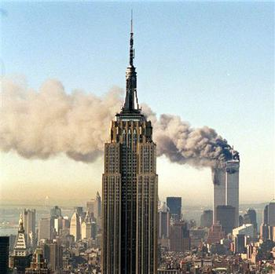
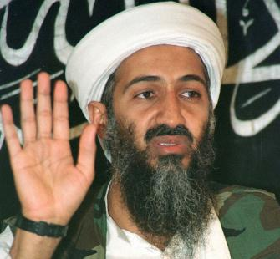
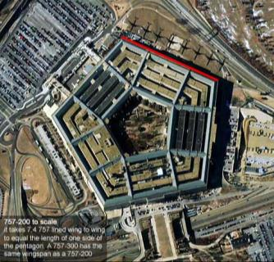
9/11: The Exposure of a Superpower
Notes:
9/11 brought into question the ability of the US to defend itself. Its position as the world’s superpower did not appear as stable as it had. Power changes over time and the US does have vulnerabilities.
Other groups around the world were able to destabilise the world’s superpower. Power is not confined to national governments.

Slide 20
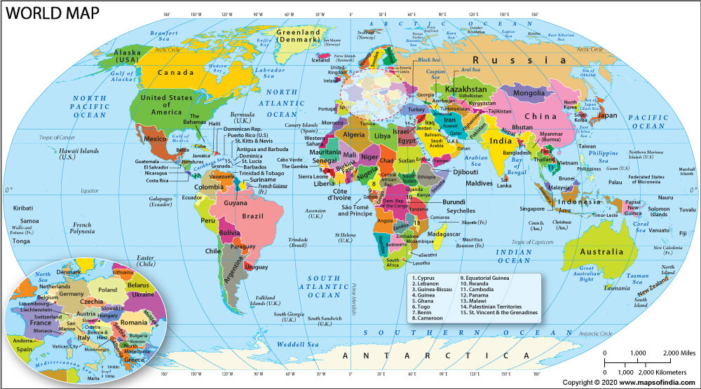
Where would you want to rule?
Task: With your partner, discuss why these might be contested regions….
Consider the words long term and short term when discussing each location

Slide 21
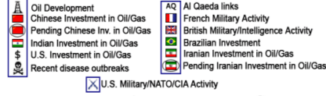
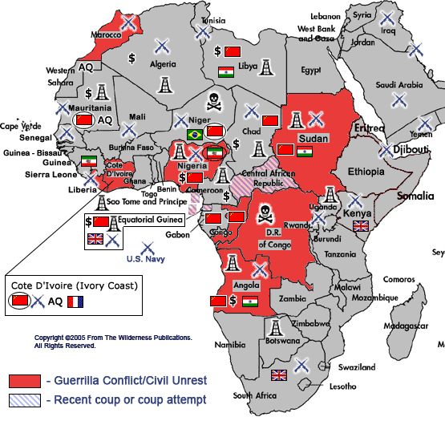
China and the US in Africa
Africa at the
Boiling Point
Notes:
Some suggest that there is a new scramble for resources in Africa, particularly from China are keen to trade with the continent. This economic interest can be seen as an international extension of power.
However, some people claim that Africa is ‘at boiling point’ – whereby continual resource exploitation leads to political instability.

Slide 22
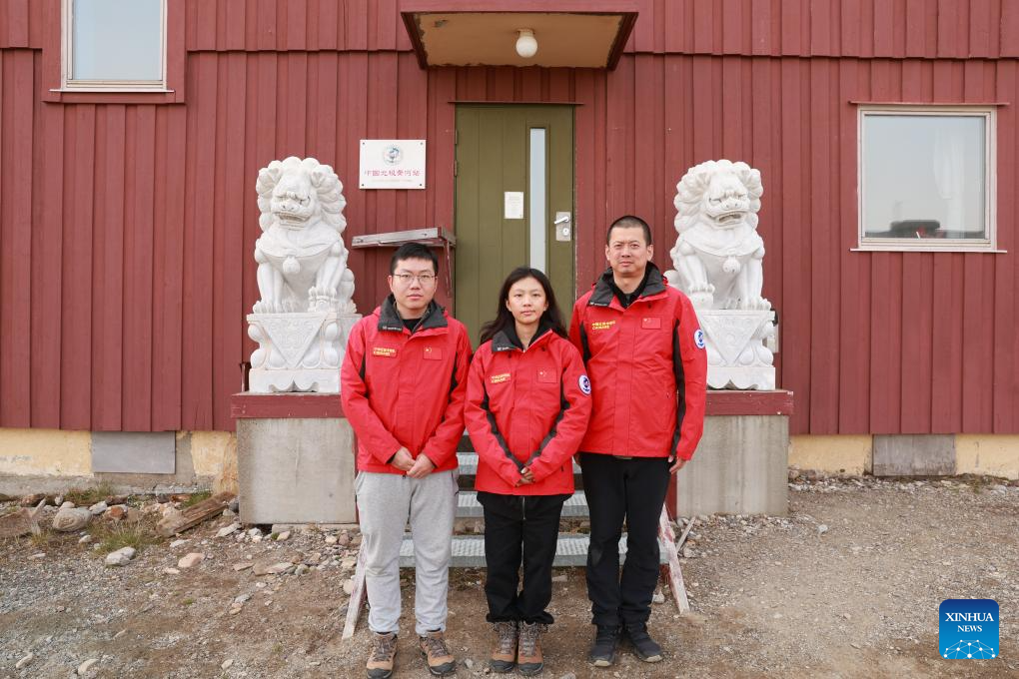
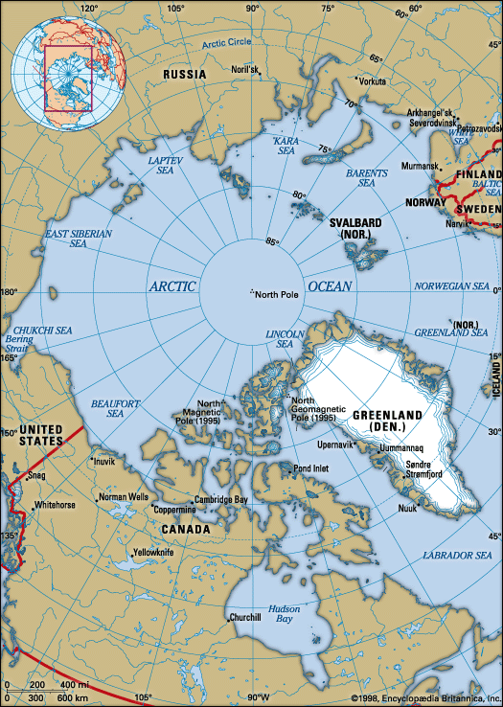
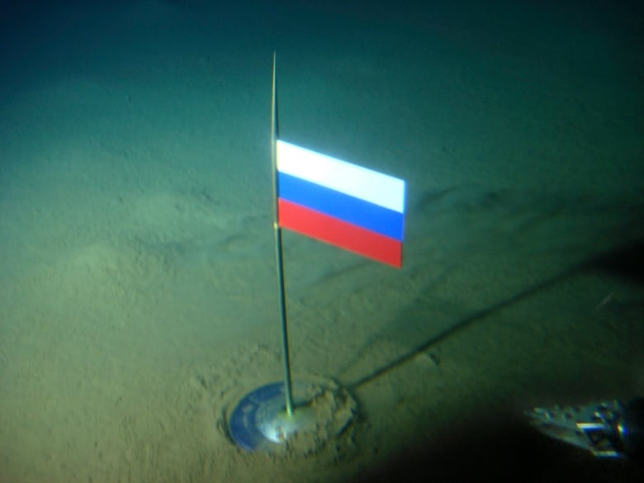
Superpowers and the Polar Regions
China has a research stations in Svalbard and in Antarctica
China conducts research around central Arctic Ocean
China believes Arctic will be a resource rich frontier
Notes:
However, China isn’t just investing in Africa – it is also interested in extending its activities to the Polar regions
The polar regions may well be the next resource-rich frontier, with large amounts of natural gas and oil possibly lying there
Having knowledge of these regions, through research around the central Arctic Ocean, China is looking towards the future
Note the important of securing energy resources in order to fuel the economic growth of a superpower

Slide 23


Independent Task
You also have a task/tasks to complete over the summer. This task must be handed in on your first lesson in September. Completing the task is part of your conditions of acceptance on the course.
The task will be available on the school website from today.
Task details:
Pick 3 different sources of geographical information
Read/watch/listen and write a short review
Your task is:
Read 2 short BBC articles and answer a short set of questions on each, full sentences please.
This task should take 25 minutes. You should complete it in the Post-16 study area.
Once complete, submit your printed or hand written task to Mrs Stapleton
Deadline: Today Time: 3pm.

