Slide 1

Physics induction
Useful resources for this summer prep and throughout the course

Slide 2
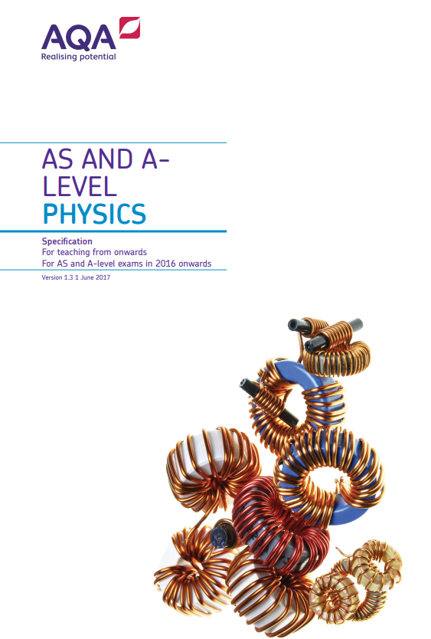
Exam board specification:

Slide 3
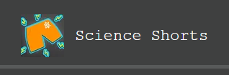
Revision videos:

Slide 4
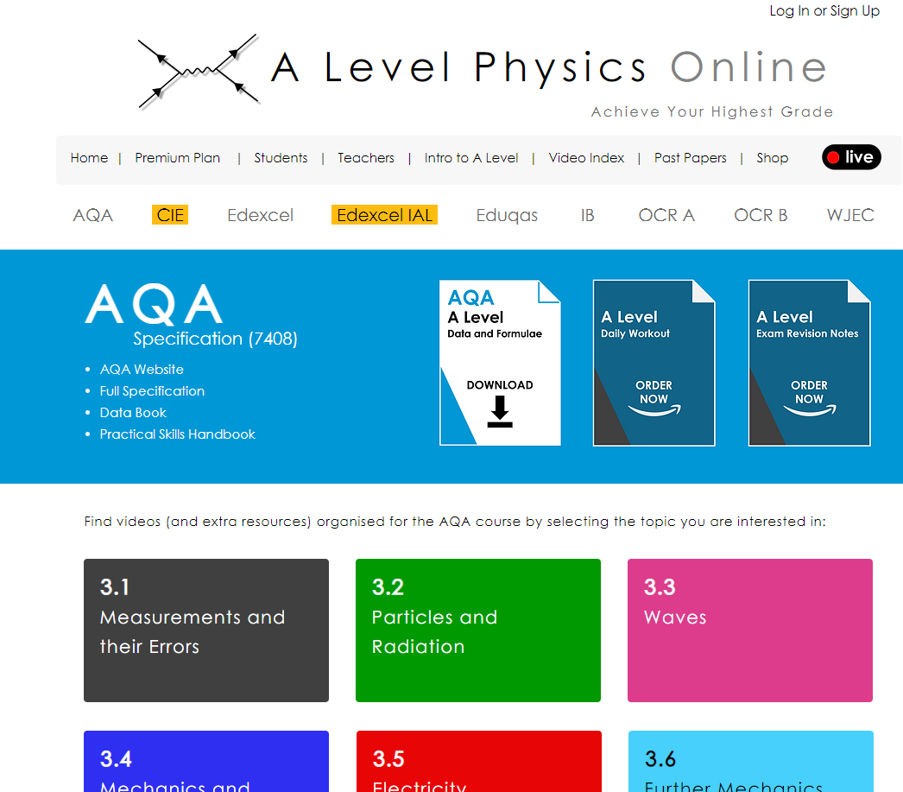
More videos:

Slide 5



Practice questions and revision

