Slide 1
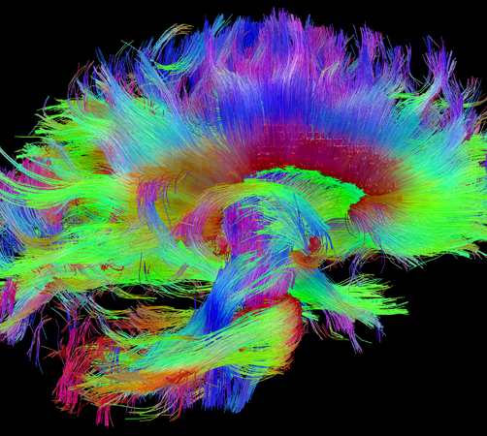
Year 12 Psychology Transition Session
Mrs Dulson
ndulson@coombedean.co.uk

Slide 2

Psychology is….
Finish the sentence on the whiteboards
The science of the brain and behaviour.
Yes, it’s a science, so we’ll be looking at maths, research methods and biology (biopsychology and neuroscience)
Clinical
Forensic
Educational
Occupational
Sports
Health
Neuropsychology
Social
Child
Counselling
Environmental
https://www.tutor2u.net/psychology/reference/why-study-a-level-psychology-open-day-evening-video
https://www.bps.org.uk/what-psychology

Slide 3
Questions to discuss (5 minutes)
Would you kill a person if told to by someone in authority?
Would you agree with a person to fit into a group?
Can you create a phobia?
Does your childhood determine the future you will have?
If a parent has OCD, will the child have it too?
Would you copy someone’s behaviour if you looked up to them?

Slide 4
What will you learn?
3 exams at the end of year 2 (2 hours each)
Paper 1
Social Influence
Memory
Attachment
Psychopathology
Paper 2
Research Methods
Biopsychology
Approaches
Paper 3
Issues and debates
Plus 3 options…
This year we did
Schizophrenia
Forensic Psychology
Relationships
Research Methods within every paper

Slide 5
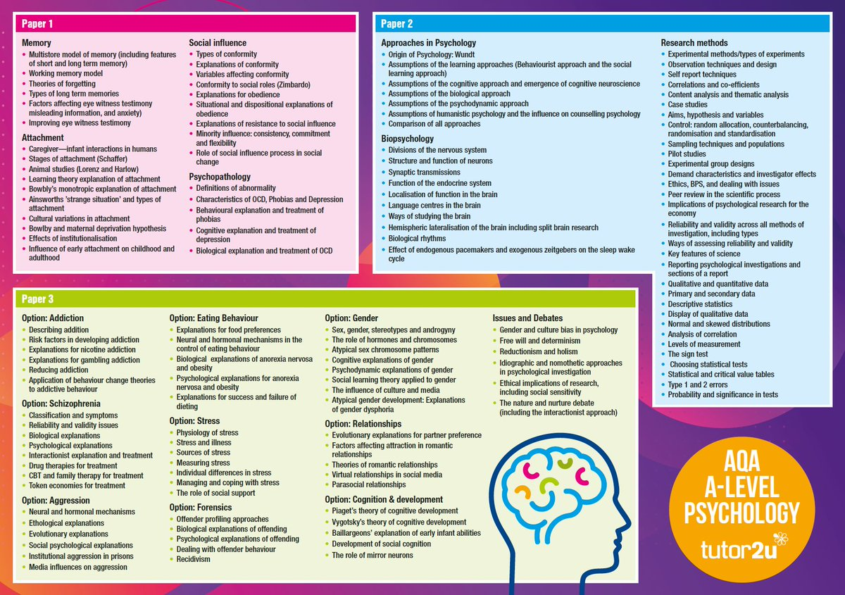

Slide 6

Approaches: What might influence our behaviour?

Slide 7
These are 5 of the approaches we use in psychology.
Each of these state that our behaviour is caused by different factors
Biological Approach | Assumes that all behaviour is due to physiological factors such as genes and neural (brain) factors
Cognitive Approach | Assumes that all behaviour is due to the way we think about/process the world
Psychodynamic Approach | Assumes that all behaviour is due to repressed emotions from trauma in our childhood
Behavioural Approach | Assumes that all behaviour is due to learning from the environment through reinforcement.
Social Learning Theory | Assumes that all behaviour is due to observing and imitating role models.
Where would each of these approaches fall on the nature nurture “spectrum”

Slide 8
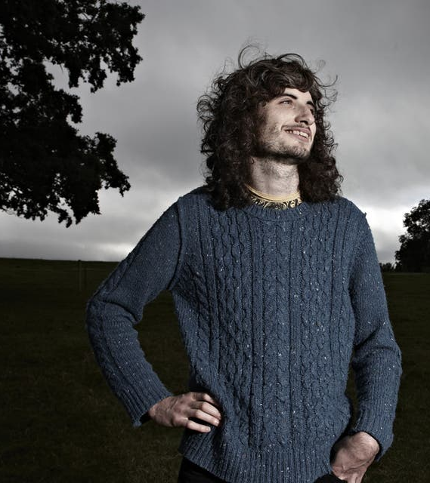
Task
Watch the clip on James who has OCD (Obsessive compulsive disorder)
What factors may have caused James to develop the condition? Use the 5 approaches to help you.
You can "guess" at the details of James' life if this helps with your answer.
Write a short summary of your ideas.
https://www.youtube.com/watch?v=E2W9guFmheI
Notes:
https://www.youtube.com/watch?v=E2W9guFmheI

Slide 9
At 23, university student James is bright and engaging but has spent most of his teenage years in and out of psychiatric institutions suffering from extreme OCD.
He lives on an isolated farm in the Cotswolds with his mum Penny who's seen her son’s life torn apart by an irrational fear that he cannot control his bowel movements. He has spent up to seven hours at a time in the toilet - too scared to leave in case he has an accident. Last year James' anxiety became so severe that he had to drop out of university.
Penny talks about how she’s lost the little boy she once knew and how she’s desperate for him to live a normal life again. The rituals and behaviour of people like James can often seem odd or bizarre but they are driven by a less well-known aspect of OCD called intrusive thoughts.
James was treated at Bethlem Royal Psychiatric Hospital’s specialist residential anxiety unit and responded well to the 12-week therapy programme. He has since been able to return to university.

Slide 10


Independent Task
You also have a task/tasks to complete over the summer. This task must be handed in on your first lesson in September. Completing the task is part of your conditions of acceptance on the course.
The task will be available on the school website from today.
Task details:
Using the booklet uploaded, research and complete the workskeets on issues and debates (IDAs) that we cover in psychology. There are links to the online book plus some useful websites to help. Or you can google the key terms.
Your task is:
Watch the clip on James who has OCD (Obsessive compulsive disorder)
What factors may have caused James to develop the condition? Use the 5 approaches to help you.
You can "guess" at the details of James' life if this helps with your answer.
Write a short summary of your ideas.
This task should take 25 minutes. You should complete it in the post 16 study area.
Once complete, submit your task to Mrs Dulson
Deadline: Today Time: 3.00

Slide 11
Advice from Year 12 psychology students:
What advice would you give to a Year 12 student at the start of their A Level psychology journey?
There’s a lot of info to take in, although it’s really fun and a great subject to take, if you can write essays
Go over information you don’t understand as soon as possible
Keep on top of your notes and be organised
Get ready for lots of content
Revise from the start.

