Slide 1

A Level Sociology Summer Work

Slide 2
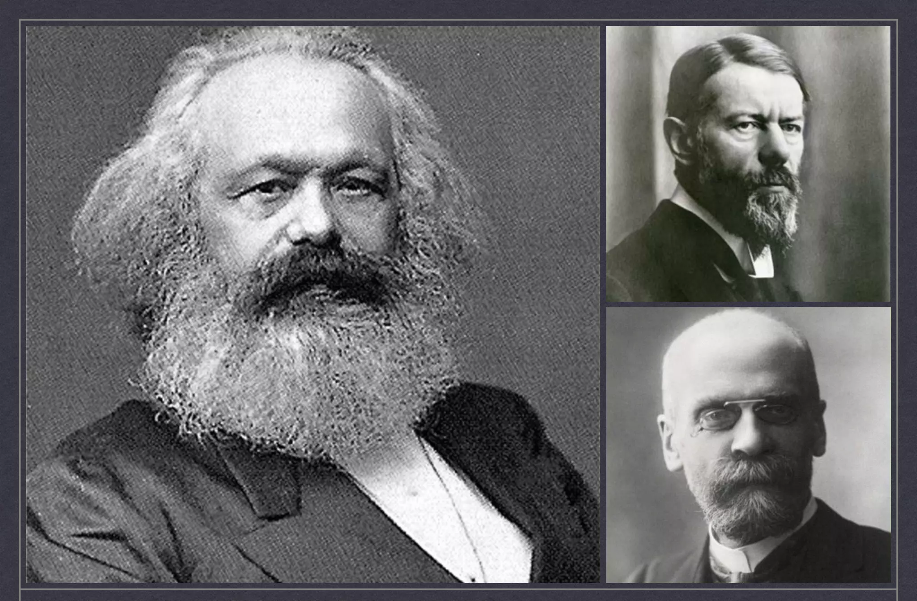
Summer Work
Sociology contains many key concepts and theories. Understanding and being able to apply these can help to enhance your ability and maximise your grade.
Your summer work is to carry out the research questions on the next slide. These will help to give you a head start in developing these skills
This can be written down or typed on word to be sent to your teacher for September.
You can use websites and watch youtube videos. Try and use websites that are aimed at students. If using AI to assist you, ask it to explain this to an A level student. It is more effective if you can really understand it.

Slide 3
Summer Work: Concepts
Define what is meant by culture. Explain how another culture is different from Britian (use some examples)
Define Values- Give two values in Britian
Define Norms- Give two norms in Britian
Define Socialisation
What are the agents of Socialisation? How may these help to shape an ethic identity? E.g You are a Nigerian child- how may these help to build this idea in you as a person or encourage you to see yourself as this?

Slide 4
Summer Work: Theory
Write a short summary of how Marxists view society.
-Include the key terms: capitalism, bourgeoise, proletariat,
Apply it: How would Marxists explain Criminality
Write a short summary of how Functionalists view society.
Include the key terms: functional, value consensus
Apply it: How would functionalists explain Criminality
Write a short summary of how Feminists view society.
Include the key terms: patriarchy, oppression/oppressed, glass ceiling effect
Apply it: How would functionalists explain Criminality
Write a short summary of how Interactionists view society.
Include the key terms: labelling theory, interactions,
Apply it: How would Interactionists explain Criminality

