Slide 1

New AQA Spec
For 2015
A Level Psychology
Introduction Summer Project
The A Level in Psychology is a fun, embracing yet challenging qualification. It will develop your thinking skills and vastly expand your knowledge of human behaviour. Please complete the activities in this booklet in readiness to begin your studies. This will give you a head start in some of the areas students most often find most complicated.
This will show us your commitment and may be used alongside your GCSE grades and behaviour as entry criteria – sixth form study is hard work and there are no short cuts. Commitment to your studies is essential. Good Luck!
Good luck and Enjoy your summer ☺
Mrs Skelly & Mrs Dulson

Slide 2
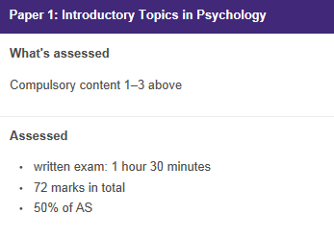
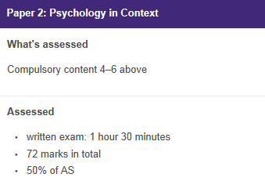
Course Information
A Level Year 1 (100% exam)
Topics:
Social Influence
Memory
Attachment
Psychopathology
Topics:
Research Methods
Approaches in Psychology (including Bio Psychology)
Look at the specification for more detail about these topics. You can find this at: https://filestore.aqa.org.uk/resources/psychology/specifications/AQA-7181-7182-SP2015.PDF
You will be expected to know and understand (AO1) the information about the topics, to be able to apply (AO2) that knowledge and understanding and to be able to analyse and evaluate (AO3) that knowledge and understanding.

Slide 3
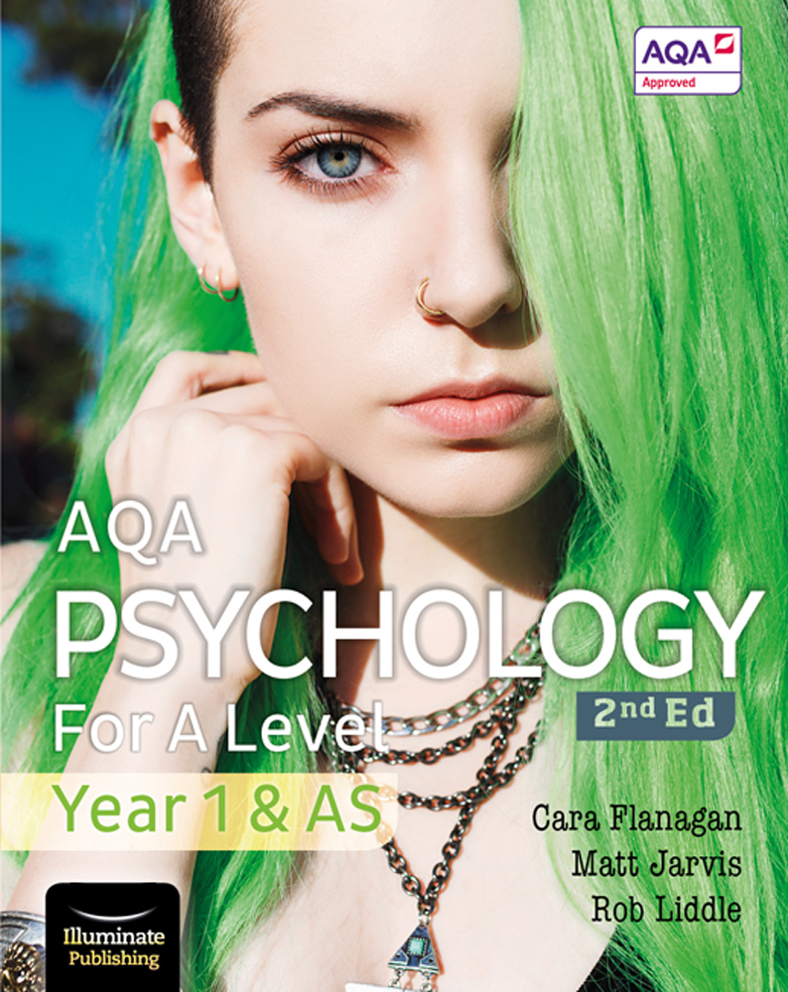
Course Information
A Level Year 1
Qualification | A level Psychology
Teachers Names | Mrs Dulson
Contact Emails | ndulson@coombedean.co.uk
Exam Board Link | AQA www.aqa.org.uk
Specification Details | 7182
Recommended Learning Links | https://www.simplypsychology.org/a-level-psychology.html https://www.senecalearning.com/ https://www.tutor2u.net/psychology https://psychologylockdown.wordpress.com/ https://www.youtube.com/channel/UCEA_qlpBQW9WzzjYUQ5-iIg https://www.youtube.com/channel/UCqqIPOTshm8EM8CCWkCy9Pg
Text Book | Year 12 textbook (2nd Ed) by Cara Flanagan, Matt Jarvis, Rob Liddle Published by Illuminate Publishing Out early May 2020 NOTE: You can buy this book from Amazon, or access the online version. We have class copies but these need to stay in the classroom
Online Textbook Details | https://www.illuminate.digital/aqapsych1/ User: SCOOMBE Password: STUDENT

Slide 4

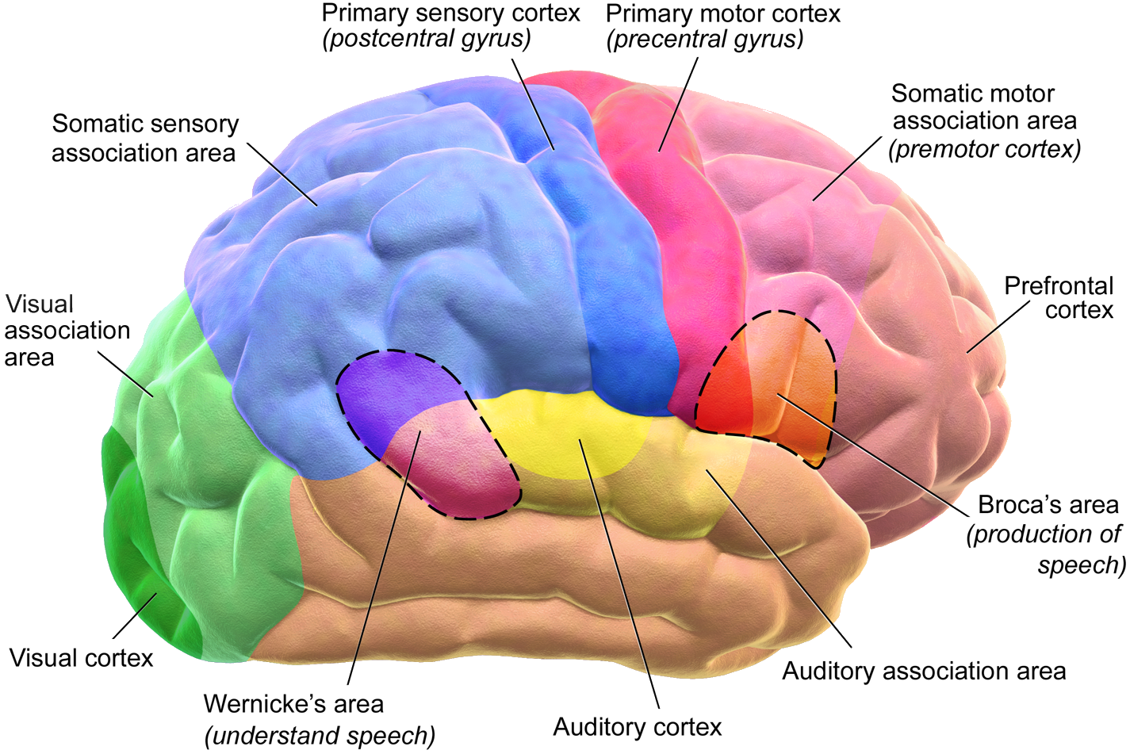
Introductory Work
Task 1: Issues and debates research
https://www.simplypsychology.org/a-level-psychology.html
Use the link and carry out your own research to fill in these help sheets on the issues and debates. These are SO important to your study and understanding these points and how to write them helps you to become a strong Psychologist
Sheets are on the next 3 slides
Determinism
Free Will
Task 2: Approaches research
Make sure you are familiar with the different approaches that we looked at in the introductory session
Biological
Cognitive
Behavioural
Social Learning Theory
Please print and hand in all work on the first day back!!

Slide 5

Task 1: Issues and Debates
https://www.simplypsychology.org/a-level-psychology.html
Determinism VS Free Will
Determinism
Free Will
Definition:
Example in psychology:
Definition:
Example in psychology:
What are the positives of determinism?
What are the negatives of determinism?
What are the positives of free will?
What are the negatives of free will
Nature VS Nurture
Nurture
Nature
Definition:
Example in psychology:
Definition:
Example in psychology:
Why can breaking behaviour down into nature or nurture be a good thing?
What Is the problem with doing this?

Slide 6
Task 1: Issues and Debates
https://www.simplypsychology.org/a-level-psychology.html
Reductionism VS Holism
Reductionism
Holism
Definition:
Example in psychology:
Definition:
Example in psychology:
What are the positives of reductionism?
What are the negatives of reductionism ?
What are the positives of holism?
What are the negatives of holism?
Idiographic VS Nomothetic
Idiographic
Nomothetic
Definition:
What data is produced:
How many people are tested on?
Does it create detail or general laws?
Definition:
What data is produced:
How many people are tested on?
Does it create detail or general laws?
What are the positives of idiographic research?
What are the negatives of idiographic research?
What are the positives of Nomothetic research?
What are the negatives of Nomothetic research?

Slide 7
Task 1: Issues and Debates
Socially Sensitive
What is meant by socially sensitive research?
Give some examples of areas of socially sensitive research?
How can this be used negatively in society?
Gender Bias
What is Alpha Bias?
What study in Psychology is an example?
What is Beta Bias?
What study in Psychology is an example?
Culture Bias
How is research in Psychology culturally biased?
Can you give a famous example?
What is meant by cultural relativism? How could this be done?

Slide 8
Useful Resources & Further Reading
To help you on your way…
Websites:
Youtube have a number of really good factual clips. In particular ‘Crash Course’ have produced a number of introductory videos to key elements in Psychology. https://www.youtube.com/watch?v=vo4pMVb0R6M&list=PLrt0cmU-e2BjX4fc9hJIF3EfsWZ3myTTJ
http://www.simplypsychology.org/a-level-psychology.html
Tutor2u has some fab resources https://www.tutor2u.net/psychology/collections
Also, a youtube channel https://www.youtube.com/watch?v=0PokyYvuL7Q&list=PLp8BSCLLWBUCuyMc0-2cHFid4x1xuXoQM
Books:
Working Memory, Thought and Action – Alan Baddeley
The Lucifer Effect – Phillip Zimbardo
Obedience to Authority – Stanley Milgram
The Complete Companions: AQA Psychology Year 1 and AS Student Book – Mike Cardwell & Cara Flanagan
AQA Psychology for A Level Year 1 and AS Student Book – Cara Flanagan & Dave Berry

