Slide 1

Summer work: Create a PowerPoint or course document on the following...
TASK 1:
What is crime? (examples)
What is deviance? (examples)
Choose one type of crime to research (honour, hate, domestic violence, white collar, state, moral, technological crime).
Include:
-Definition
-Typical Offender
-Typical Victim
Find an example or case study of this crime.
Include statistics about this crime (e.g. how many victim? Are incidences increasing?)
What are some reasons that someone may not want to report this crime if they are a victim?
TASK 2: Find a poster of a crime campaign. Explain why it is a good poster. What about It makes it convincing?
TASK 3: Research a criminal/killer of your choice. Consider what factors may have led to their crimes. Include details of their background and possible triggers.
Be ready to hand in and discuss during the first lesson in September.
lskelly@coombedean.co.uk

Slide 2
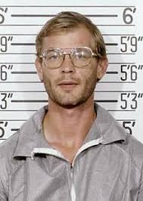
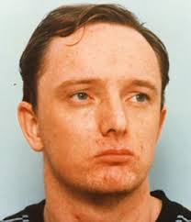
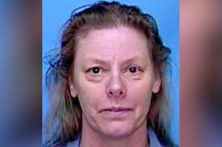
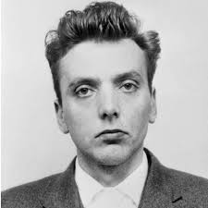
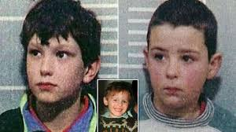
Jeffrey Dahmer
Robert Napper
Here are just some ideas – you can choose your own criminal
Ian Brady
Aileen Wuornos
John Venables – Robert Thompson

Slide 3

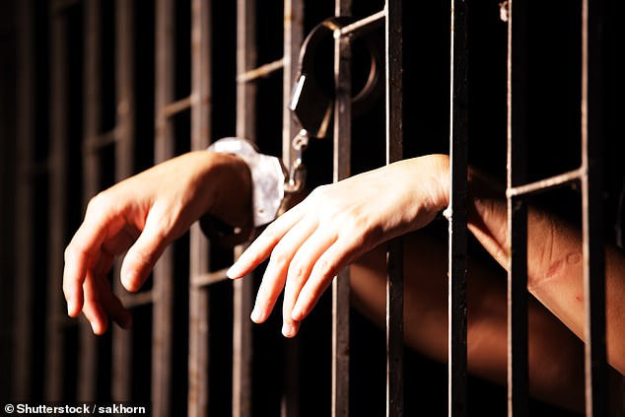
Criminology Watch List
Watching List - Criminology
Any documentaries, including Panorama, Louis Theroux, Stacey Dooley, Mind of a Murderer etc
Black Mirror series (Netflix)
Goodfellas
The Godfather (part 2 is the best)
Life and Deathrow (BBC)
McMafia (previously BBC i-player)
Freedom Writer’s Diary
Dangerous Minds
Chernobyl (drama)
When They See Us (Netflix)
White House Farm Murders (Netlfix)
TIME (BBC)
Making a murderer (Netflix)
LEGEND
Worlds Toughest Prisons (Netflix)
Tiger King
The Society (Netflix)
Blood Diamond
Ted Talks/Crime/Criminal Justice
Orange is the New Black (Netflix)
The Innocence Files (Netflix)
Cold Case Files (Netflix)
I Am A Killer (Netflix)
When They See Us Now – Oprah Winfrey (Netflix)
The Stanford Prison Experiment (Youtube)
The Push – Derren Brown (Netflix)
MacIntyre Undercover: The Chelsea Headhunters (Youtube)
The Shawshank Redemption
The Green Mile
24 Hours in Police Custardy (All 4)

