Slide 1
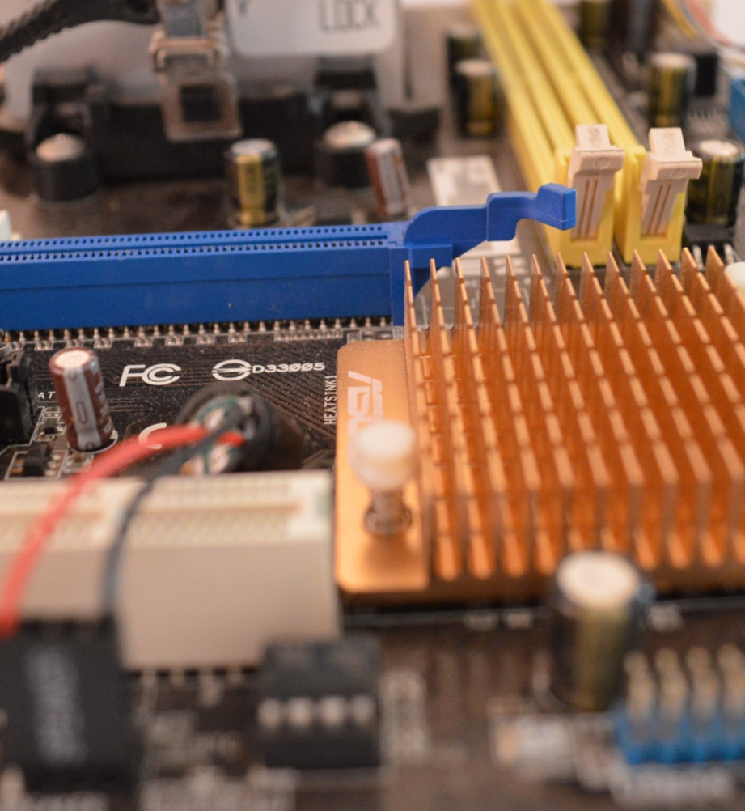
Computer Science
Transition workbook
The course is assessed by
2 exams (40% each exam) + NEA Coursework (20%)
The topic of Computer Science is at the heart of the modern world
Studying it can make you extremely sought after in todays job market
The transition from GCSE to A level is significant, this includes:
  An increased emphasis on technical content
  An increased emphasis independent research
This workbook is designed to allow you to practice some of these skills and build on your existing knowledge.
Please complete by your first lesson back in September.

Slide 2
1
“Tell me about yourself”
Why did you choose Computer Science?
Expected time to complete: ½ hour
In this simple task you get the opportunity to tell me your choices and reasons behind choosing to study Computer Science.
Please answer all questions as best you can.
1. Why did you choose to study A level Computer Science?
…
2. What other courses have you chosen to study at Key Stage 5, and what made you choose this combination?
…
3. What are you hoping to achieve from studying Computer Science?
…
4. How would you describe yourself as a learner at GCSE? What skills where you good at, what areas would you like to improve on?
…
5. What are your other hobbies and interests outside of school? Anything related to Computing?
…

Slide 3
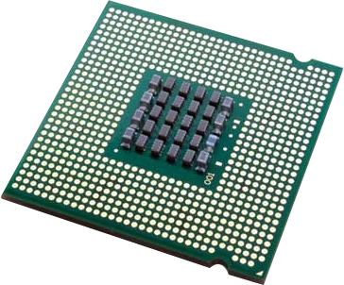
2
The CPU
The CPU “Central Processing Unit” is the central core of any computer system. You will study what it contains and how it works it in depth at A Level.
Expected time to complete: 1 hour
1) Start by watching the following video to help you understand more about the CPU and its components: https://student.craigndave.org/videos/ocr-alevel-slr01-alu-cu-registers-and-buses
2) Produce a fully annotated diagram of the CPU (Either digitally on the next slide OR on paper and take a photo).
Make sure the diagram includes the following components which should be annotated to explain their purpose and how they work.
  Main Components:
    Arithmetic Logic Unit (ALU)
    Control Unit (CU)
    Cache
  The main registers:
    Program Counter (PC)
    Memory Address Register (MAR)
    Current Instruction Register (CIR)
    Memory Data/Buffer Register (MDR / MBR)
  Buses:
    Data Bus
    Address Bus
    Control Bus
Helpful links to support you:
https://www.savemyexams.com/a-level/computer-science/ocr/17/revision-notes/1-the-characteristics-of-contemporary-processors-input-output-and-storage-devices/1-1-structure-and-function-of-the-processor/components-of-the-cpu/
https://www.learnitwithdavo.co.uk/1-1-1-architecture-of-the-cpu/
https://www.teach-ict.com/2016/A_Level_Computing/OCR_H446/1_1_characteristics_components/111_architecture/parts_of_cpu/miniweb/pg2.php

Slide 4
2
The CPU
Expected time to complete: 1 hour
Add evidence of CPU diagram here

Slide 5
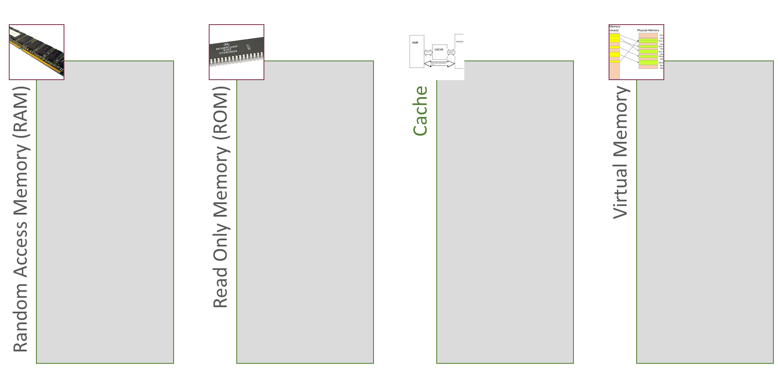
3
Primary Memory
Primary Memory is one main type of memory used in a computer system. It is memory accessed by the CPU while the computer is in use and carrying out the FDE cycle. There are several main types of Primary Memory including;
Random Access Memory (RAM), Read Only Memory (ROM), Cache, Virtual Memory)
Complete the tables below to show your understanding about these different types of Primary Memory.
Expected time to complete: 1 hour
Definition:
ANSWER
Volatile/Non-volatile:
ANSWER
Read/Read only/Write:
ANSWER
Describe usage:
ANSWER
Definition:
ANSWER
Volatile/Non-volatile:
ANSWER
Read/Read only/Write:
ANSWER
Describe usage:
ANSWER
Definition:
ANSWER
Volatile/Non-volatile:
ANSWER
Read/Read only/Write:
ANSWER
Describe usage:
ANSWER
Definition:
ANSWER
Volatile/Non-volatile:
ANSWER
Read/Read only/Write:
ANSWER
Describe usage:
ANSWER

Slide 6
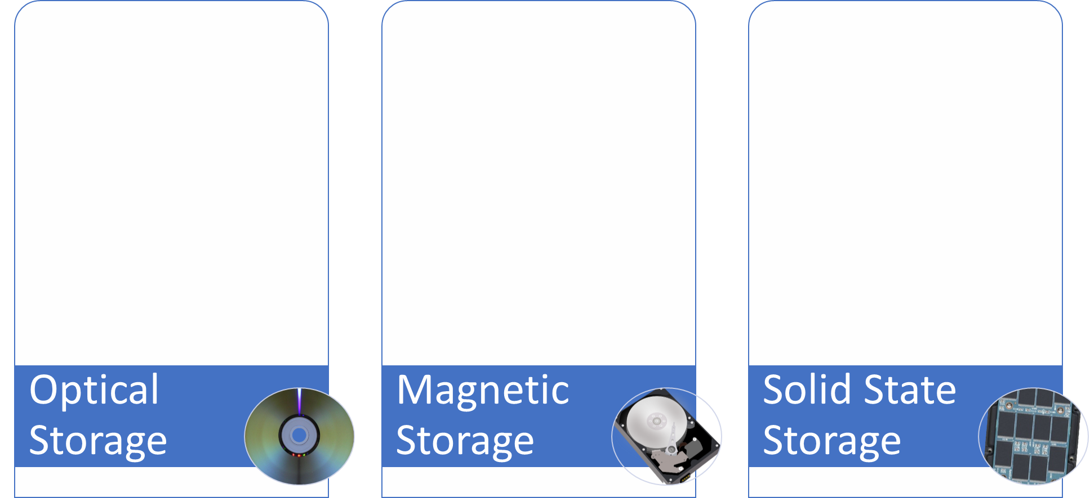
4
Secondary Storage
Secondary Storage is permanent non-volatile storage in the computer system for data when it is not in use.
Complete the tables below to show your understanding about the three main types of secondary storage: Magnetic, Solid-State, Optical
Expected time to complete: 1 hour
How does it work?
How does it work?
How does it work?
Enter your answer here…
Enter your answer here…
Enter your answer here…
Advantages / Positives
Advantages / Positives
Advantages / Positives
Enter your answer here…
Enter your answer here…
Enter your answer here…
Disadvantages / Negatives
Disadvantages / Negatives
Disadvantages / Negatives
Enter your answer here…
Enter your answer here…
Enter your answer here…
Examples of typical usage
Examples of typical usage
Examples of typical usage
Enter your answer here…
Enter your answer here…
Enter your answer here…
Typical storage capacity range
Typical storage capacity range
Typical storage capacity range
Enter your answer here…
Enter your answer here…
Enter your answer here…

Slide 7








5
Networks
A LAN (Local Area Network) has lots of different components that make up a network. The layout of devices in the network is called the Topology. Remember that networks can either be Peer-to-Peer or Client-Server based!
a) Using the components provided, create a topology diagram for a Client-Server based LAN network that has the following criteria:
5 Desktop PCs connected to a Switch using Ethernet cables
2 Laptops connected to a WAP
1 Printer connected to the Switch using Ethernet cables
A central server connected to the Switch
A single Router connected to the Server to access the Internet
A Firewall device that sits between the Server and the Router
b) Annotate the topology diagram to explain the purpose of each type of device used in the network.
Expected time to complete: 1 hour
Ethernet Cable =
Wireless (Wi-Fi) =

Slide 8
6
Binary & Hex
Complete the following questions to practice and revise what you already know about Binary and Hexadecimal number systems.
You can complete on paper and add a photo of your work if it is easier. Make sure you show your workings for each question.
Expected time to complete: ½ hour
1) Convert the following from Binary to Denary
3) Convert the following from Binary to Hexadecimal
01101010
11010110
1 11101011
10110111
01101111
11 00101110
2) Convert the following from Denary to Binary
4) Convert the following from Hexadecimal to Binary
125
201
290
C8
9A
48D
You may wish to cut and paste this standard binary weighting line to help lay out parts of your answer
128 | 64 | 32 | 16 | 8 | 4 | 2 | 1
Binary weighting
Binary value

Slide 9
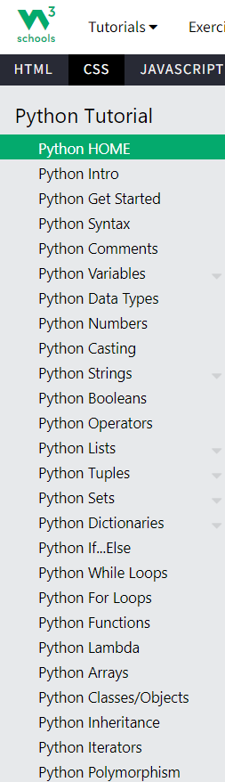
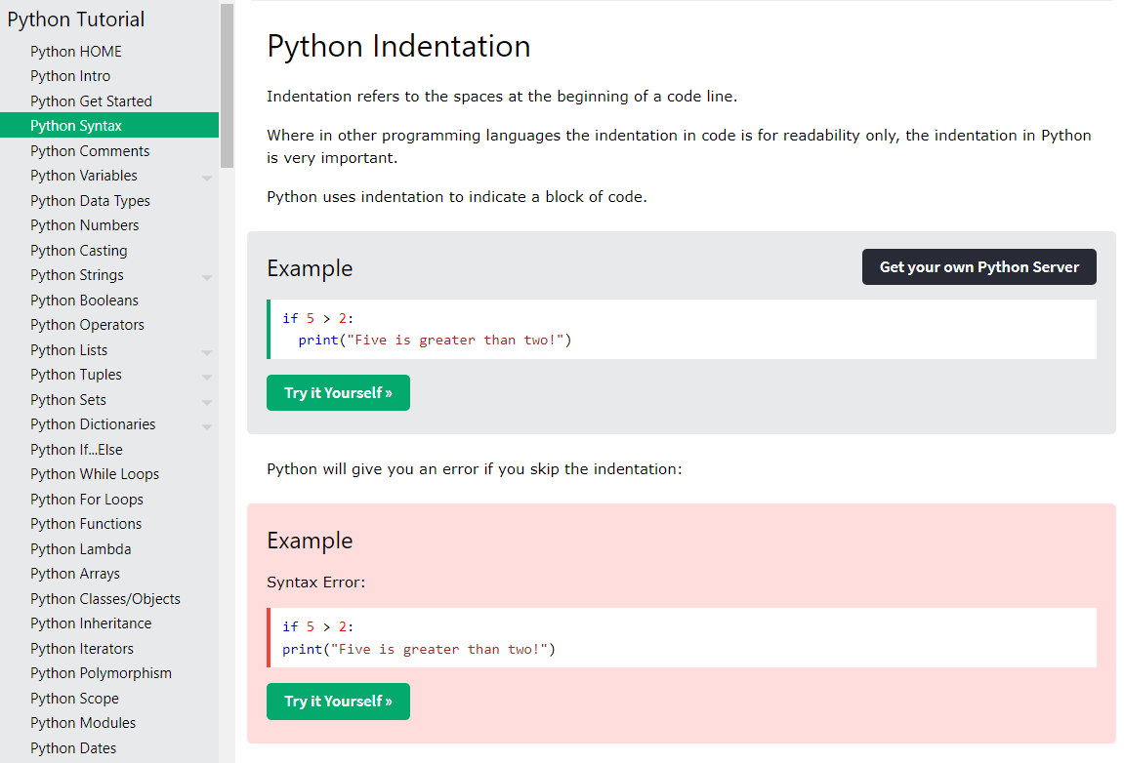
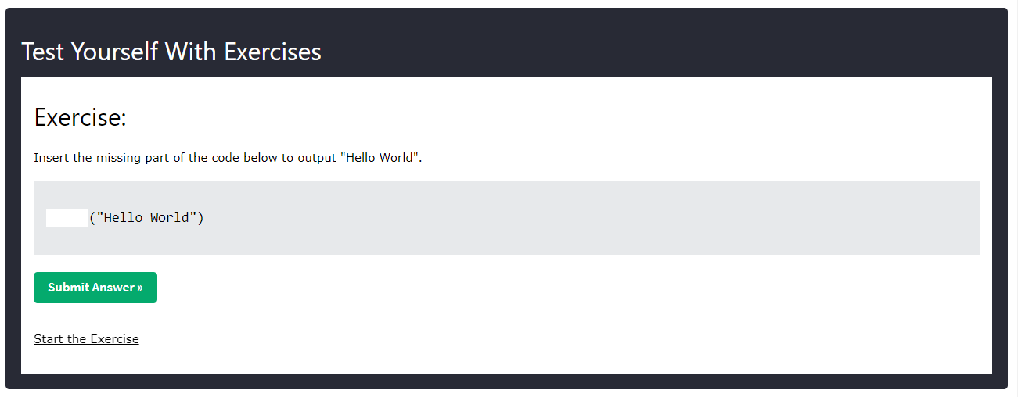
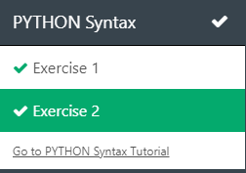
7
Python Programming Basics
We will be continuing to use the Python programming language a lot more into A Level with new skills and techniques being learnt. It is important to revise and make sure you are confident with the basics first though.
Go to the website: https://www.w3schools.com/python/default.asp
Work through the different Python tutorial stages all the way up to ‘Functions’
(If you want to go further and learn more, feel free!)
  Tutorials - Read through and try out the different Examples in each section.
  Make sure you understand what it is saying and doing!
  Exercises – At end bottom of each section there are some exercise
  questions to complete. Make sure you complete each exercise
  section all the way up to ‘Functions’ as shown on the right
  Direct link to exercises can be accessed here:
  https://www.w3schools.com/python/python_exercises.asp
  Screen-print evidence! – Screen print the exercise sections on the right to show they have been completed. There should be ticks against each exercise to show it has been completed correctly.
Expected time to complete: 2 hours
Complete
ADD SCREEN-PRINT EVIDENCE OF EXERCISES COMPLETE HERE

Slide 10
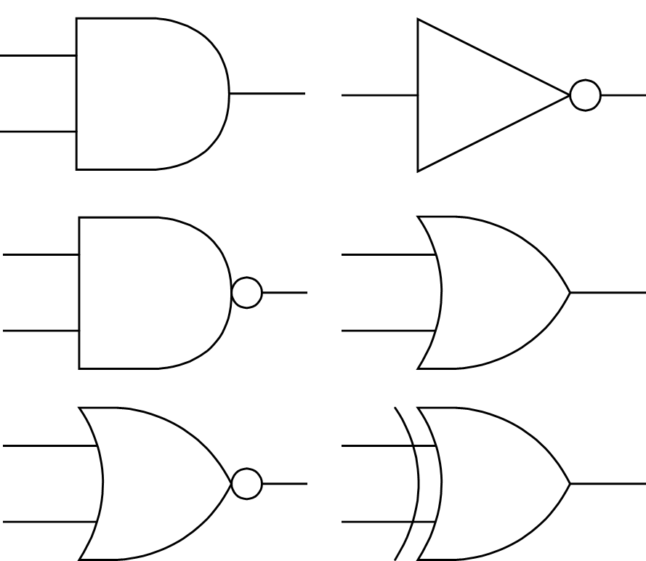
8
Logic Circuits
Expected time to complete: 1 hour
1) Drag the labels into their correct place on the following diagram
(Do the ones you know first, look up the ones you don’t!)
2) Create the logic diagrams for the following circuits.
(Use the components provided below to help you.)
A
B
C
D
E
a) E = NOT ((A AND B) OR (C AND D))
b) E = A AND (NOT B OR NOT C)
OR
AND
XOR
NOT
NAND
NOR

Slide 11
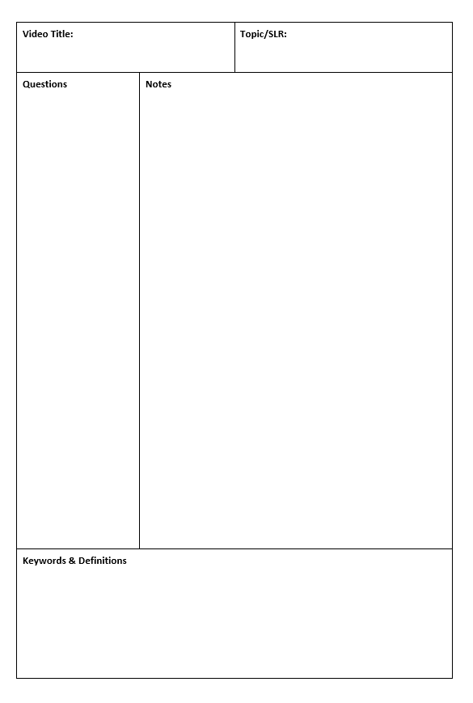
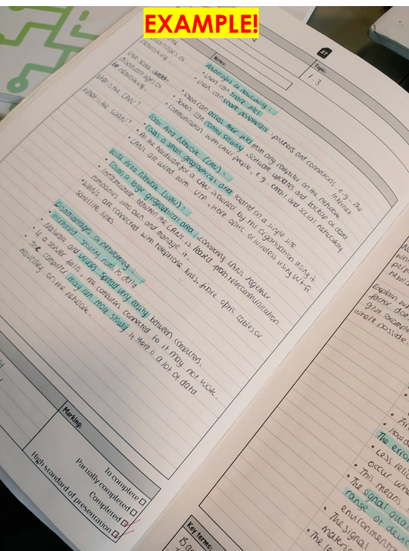
9
Cornell Notes
The Cornell method of note taking
Expected time to complete: 1 hour
The expectation to do independent research at A Level will increase dramatically from GCSE.
There is a real skill to taking decent notes outside of lesson which are of value. Research has proven that one of the most effective methods is the “Cornell” note taking method.
A blank template for ‘Cornell Notes’ has been provided on the next slide
Pick any one of the following videos from Craig ‘n’ Dave:
  OCR: https://student.craigndave.org/videos/ocr-alevel-slr01-alu-cu-registers-and-buses
  OCR: https://student.craigndave.org/videos/ocr-alevel-slr04-paging-segmentation-and-virtual-memory
  OCR: https://student.craigndave.org/videos/ocr-alevel-slr05-stages-of-compilation
  OCR: https://student.craigndave.org/videos/ocr-alevel-slr14-data-structures-part-2-graphs
Write the title of the video and its topic in the top boxes (use a different sheet for each video).
In the main “Notes” section, write notes from the video. You can do this in any way you like, a suggestion might be to rewind slightly when the canvas changes, thinking carefully about what was important in the previous few minutes.
Having recorded the notes, review them:
  Turn each part into a question in the section on the left.
  For example, the notes may say, “The value of the program counter is passed to the memory address register”.
  The question then becomes, “which register is the value of the program counter passed to?”
  Sometimes these questions are easy, and at times they are more difficult to write.
  There may also be more than one valid question.
  You will need to decide for yourself which are the most appropriate questions for revision.
Finally pull out all the key words and their definitions words the notes and list them in the bottom section.

Slide 12
9
Cornell Notes
The Cornell method of note taking
Expected time to complete: 1 hour
Video Title: |  |  | Topic/SLR:
Questions | Notes | Notes
Key Terms

Slide 13
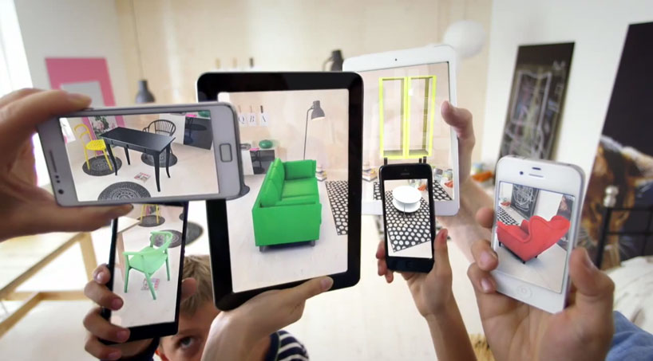
10
Essay Topic
Augmented reality
Expected time to complete: 2 hours
QUESTION – Does the use of Augmented Reality help to improve the quality of life for human? [9]
A key skill at A Level is being able to take a topic and then discuss it in the context of different scenarios.
Most theory-based exam questions will be asked in the form of a scenario, simply regurgitating what you know on the topic without contextualising your answer to the scenario will often result in low marks!
The topic for this exercise is “Augmented Reality”. It is a truly fascinating area of technology which has the potential to change almost every aspect of our daily lives.
Watch this brief video to learn more: https://www.youtube.com/watch?v=vQtwWzfzKXI
After watching the video, consider the question above, “Does the use of Augmented Reality help to improve the quality of life for human?”
Complete the next slide which asks you to discuss this question. Think about the different uses of Augmented Reality. Consider the following areas of life, how can it be used in areas such as:
Medicine & health care
Gaming & entertainment
Education
Travel & tourism
Social media
Transport & navigation
Image by Oyundari Zorigtbaatar (20 March 2016) https://creativecommons.org/licenses/by-sa/4.0/legalcode

Slide 14
10
Essay Topic
Augmented reality
Expected time to complete: 2 hours
QUESTION – Does the use of Augmented Reality help to improve the quality of life for human? [9]
When completing ‘long-answer’ questions at A-Level, you will be marked using the following: 1) Knowledge 2) Application 3) Evaluation
1) Knowledge – Explain what you know and understand about what Augmented Reality is. Give as much detail as you can after researching the topic.
ANSWER
2) Application – Discuss examples of how Augmented Reality are used or could be used. Try to include examples from different areas including:
Medicine / Health care, Gaming/Entertainment, Education, Travel & tourism, Social media, Transport/Navigation
ANSWER
3) Evaluation – Give your overall conclusion. Does Augmented Reality really improve the quality of human life? Justify your overall evaluation with reasons why.
ANSWER

